Slide 1
Individual Permit Public Website
Karly Rodriguez

Slide 2
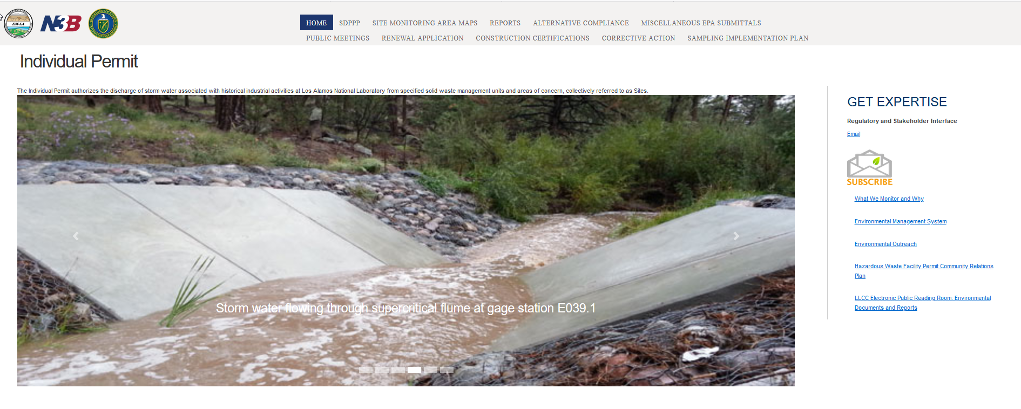
Homepage
URL: https://ext.em-la.doe.gov/IPS
Or google: LANL Individual Permit

Slide 3
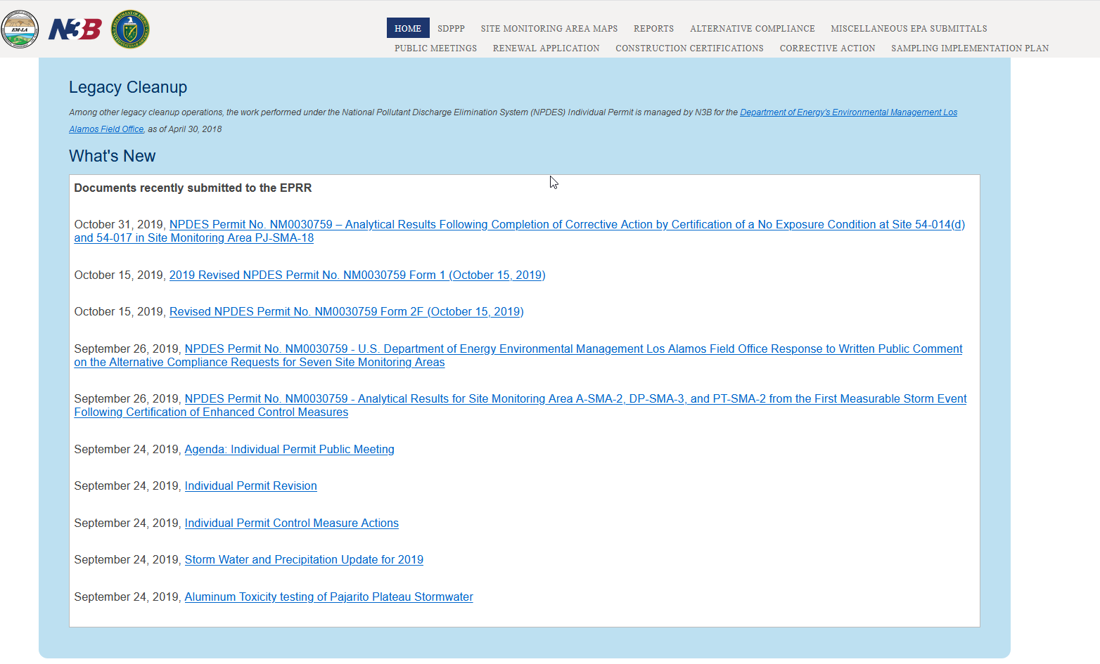
Homepage - What’s New?

Slide 4
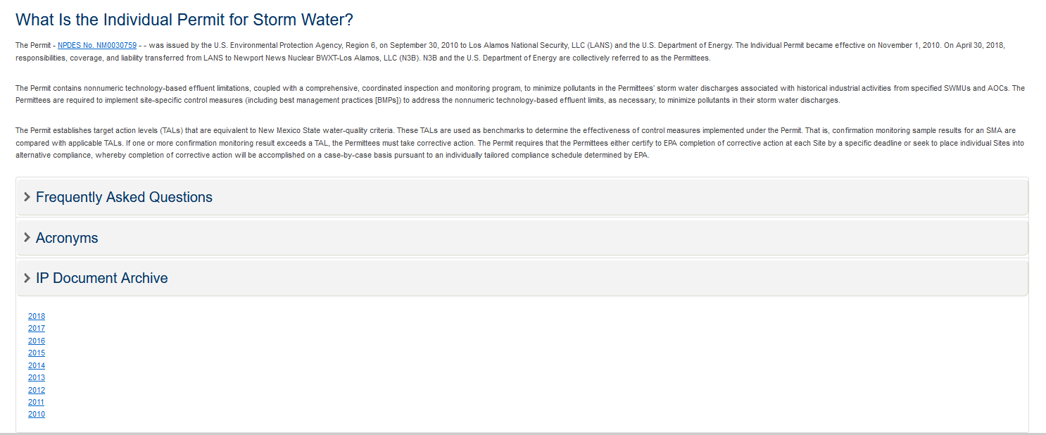
Homepage – What is the Individual Permit?

Slide 5
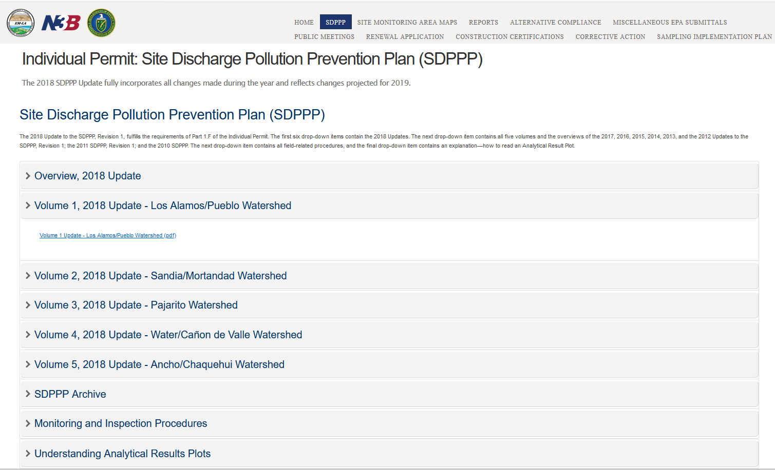
SDPPP

Slide 6
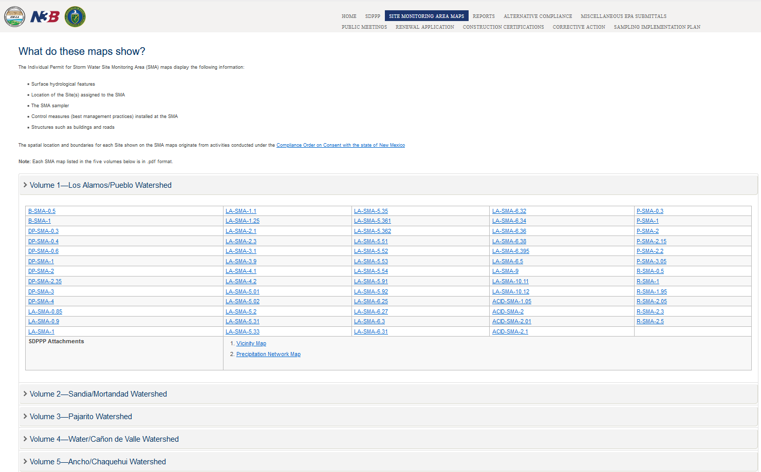
Site Monitoring Area Maps

Slide 7
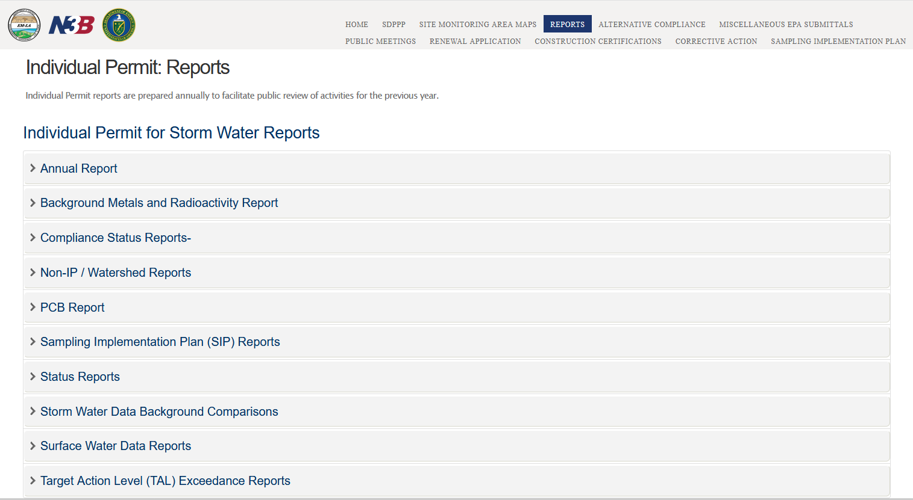
Reports

Slide 8
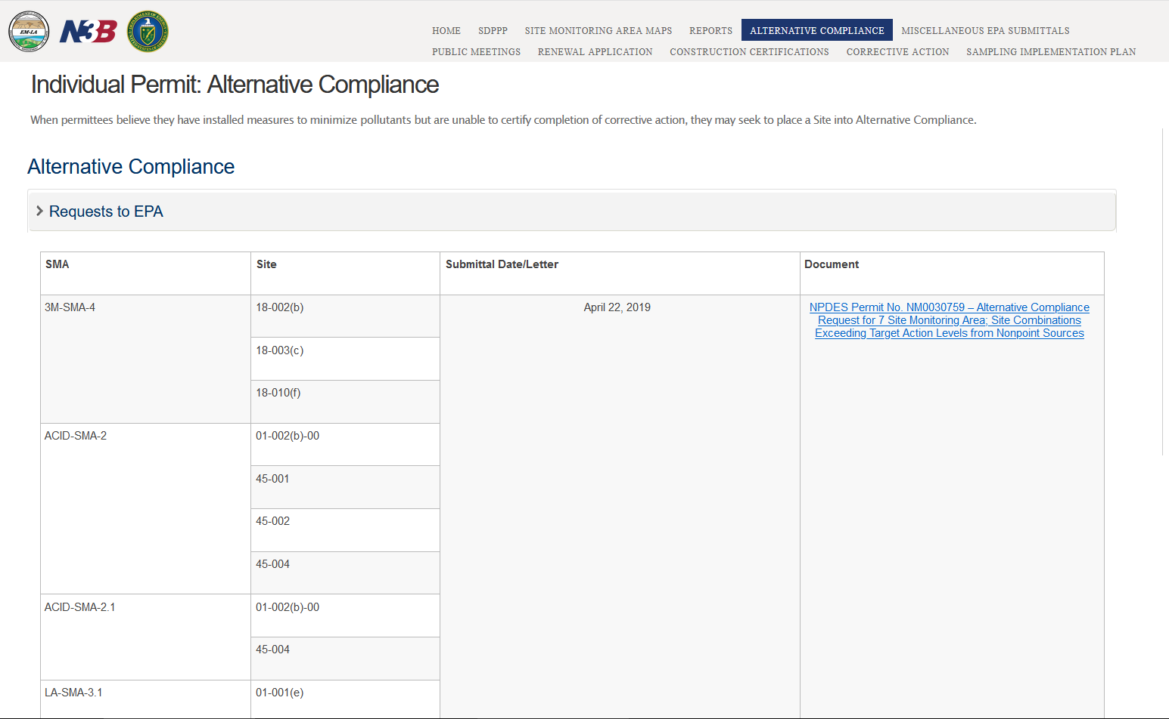
Alternative Compliance

Slide 9
Miscellaneous EPA Submittals

Slide 10
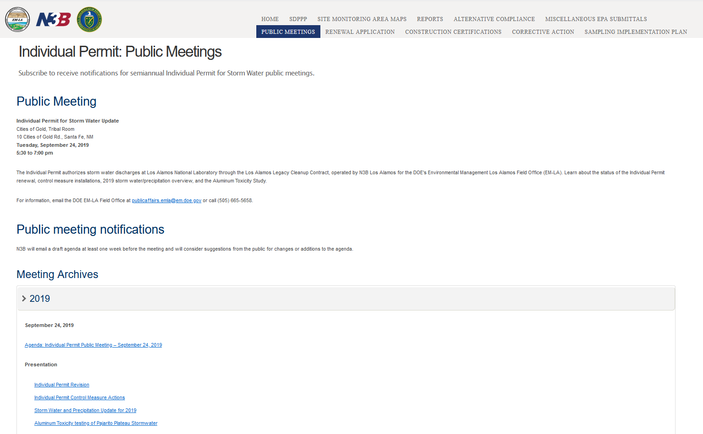
Public Meetings

Slide 11
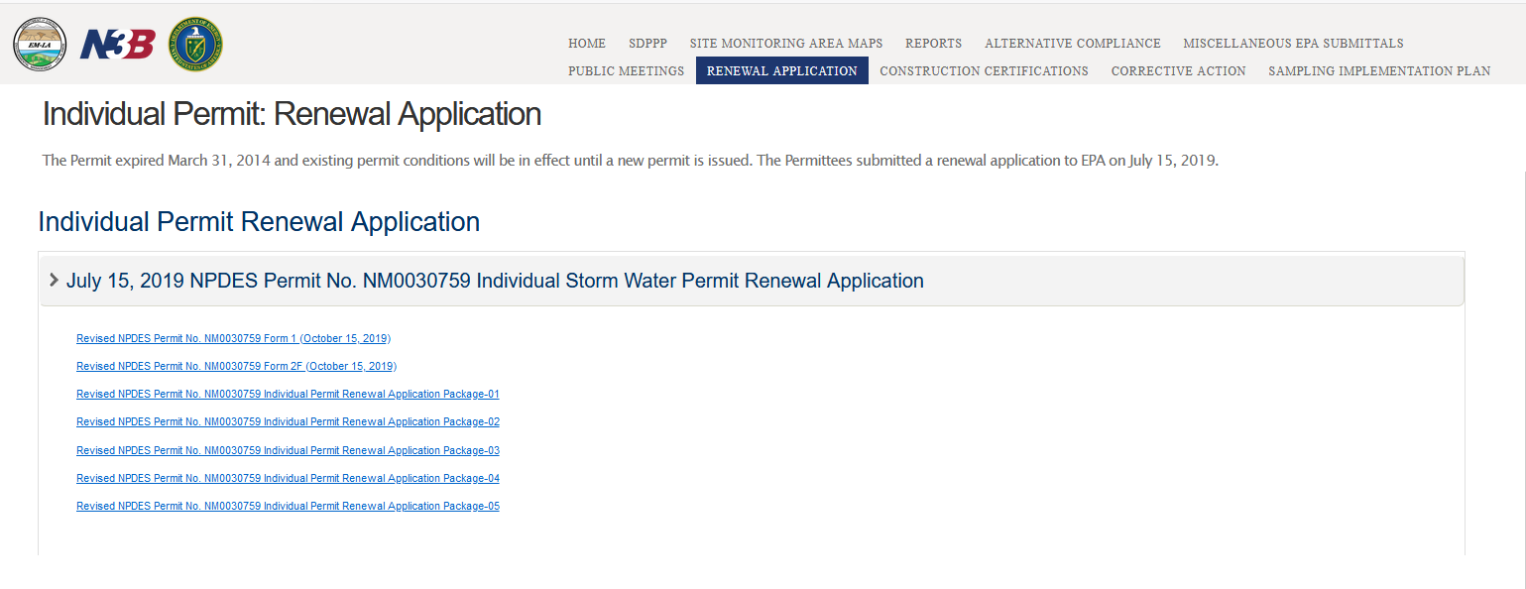
Renewal Application

Slide 12
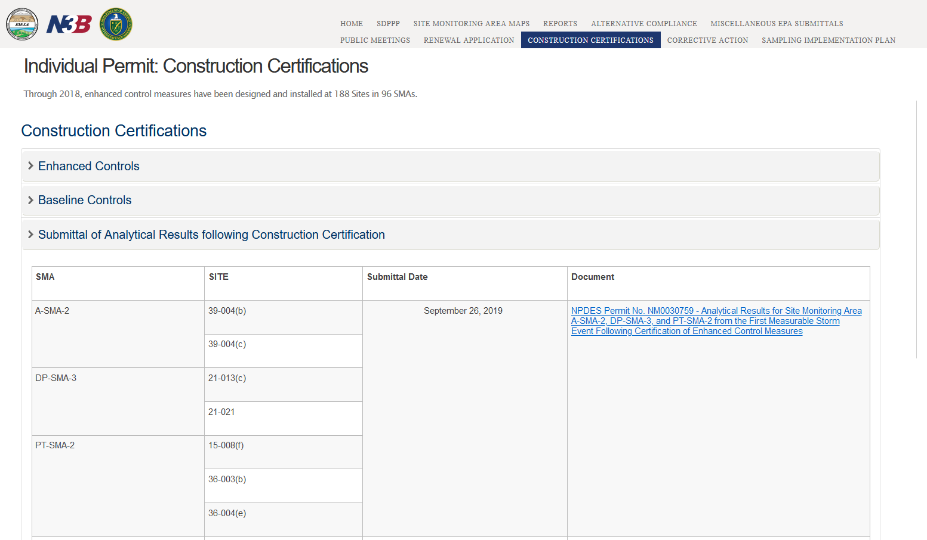
Construction Certificates

Slide 13
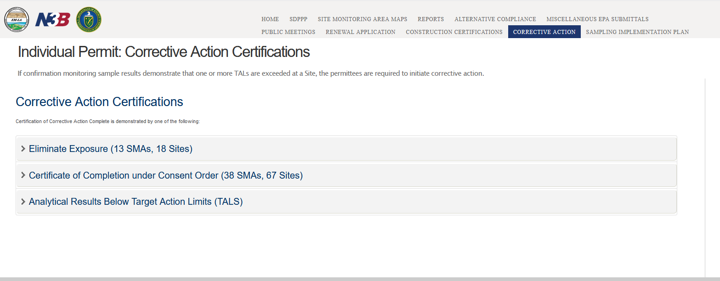
Corrective Action

Slide 14
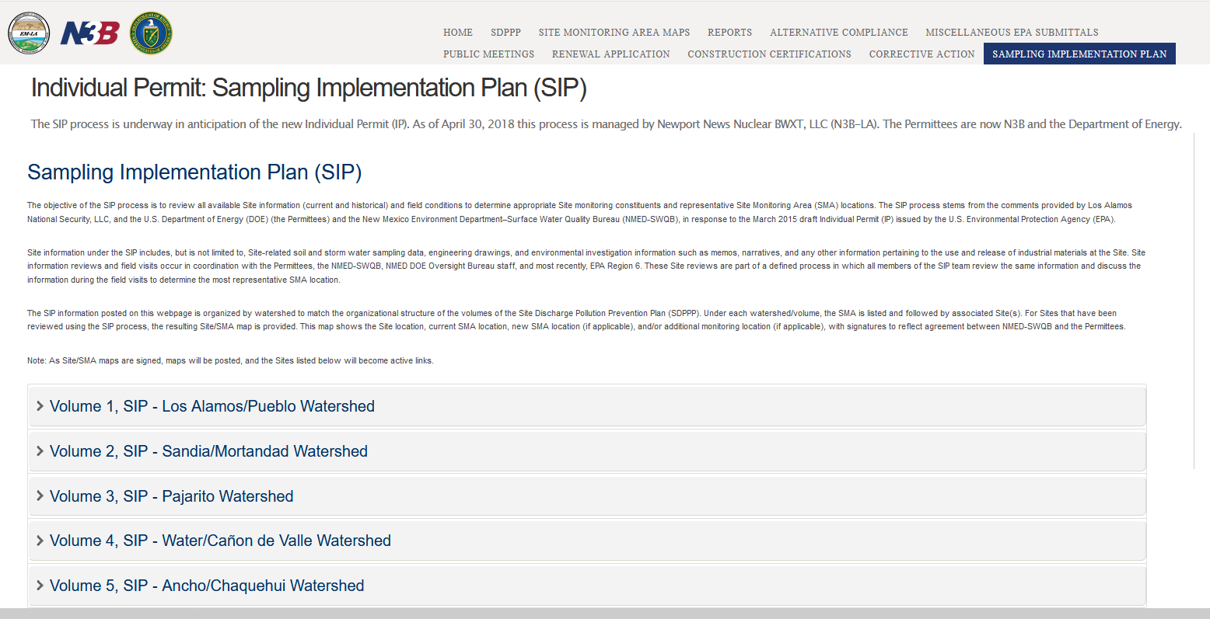
Sampling Implementation Plan

Slide 15
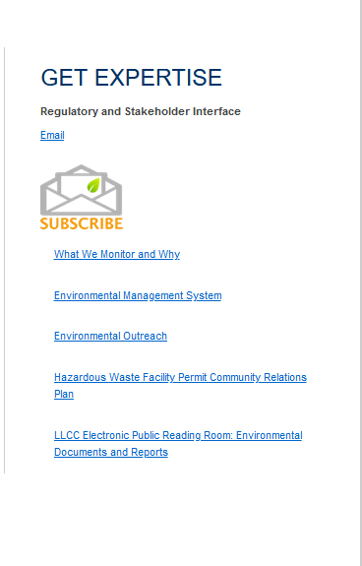
Additional Website Tools

Slide 16
Questions?

