Slide 1
Site Specific Demonstration Screening Process as outlined in the 2022 Storm Water Individual Permit (NM0030759)
November 9, 2022
Karly Rodriguez

Slide 2
Presentation Outline
Site-Specific Demonstration (SSD) Process
New Tiers
Site Deletion
Long-Term Stewardship
Corrective Action
SSD Example
Questions

Slide 3
Site-Specific Demonstration
Site History for known Pollutants of Concern (POCs)
Past reports
Historic documents
Engineering drawings
Soil Data
Collected from 0-3 feet below ground surface
Within 100 feet of the Site Monitoring Area (SMA) boundary
Screening level is 10% of the soil Background Value (BV) or 10% of the Soil Screening Level (SSL) when a background value is not available
Storm Water Data
Storm water samples from current permit stage are screened against Target action Levels (TALs) and Background Threshold Values (BTVs)

Slide 4
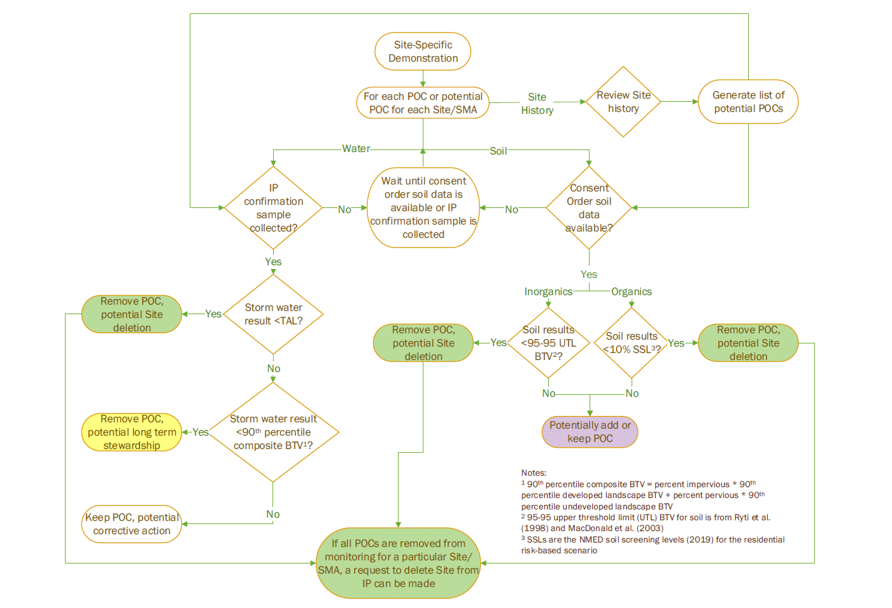

Slide 5
Site Deletion
Site Deletion Pathways:
No industrial activities took place at the Site;
Site-related POCs have never been exposed, or will no longer be exposed, to storm water;
Sites have no significant industrial materials remaining that are exposed to storm water after installation of permanent control measures;
The Permittees certified corrective actions have been completed by removing contaminated soil that was exposed to storm water and demonstrating that no significant materials from previous industrial activity remain in the Site;
SSD shows that the storm water and soil data are below screening levels for all POCs; For Long-Term Stewardship Sites, no evidence of discharge at a Site after a 25-year, 24-hour storm event; or
If the following conditions are met at a site being monitored: i) sampler is in a representative location; ii) no sample collected after a 25-year, 24-hour storm; and iii) sampler is operable during storms

Slide 6
Long-Term Stewardship (LTS)
Types of Long-Term Stewardship:
Storm water sample results are greater than target action limits (TALs) because of background contribution;
Storm water sample results are greater than human health - organism only (HH-OO) based TALs, but below wildlife habitat TALs for discharges to non-perennial streams (e.g., PCBs);
Storm water sample results exceed the Adjusted Gross Alpha (AGA) TAL before monitoring requirement of AGA was removed from the 2010 permit; or
Sites have no evidence of storm water discharges for the past five years.
Inspection Requirements: Annually and after a 3-year 24-hour (or greater) storm event.

Slide 7
Corrective Action
Once a TAL and/or composite background threshold value (BTV) has been exceeded for a Site-related POC, an appropriate corrective action is identified.
Types of corrective actions include:
Installation of enhanced control measures,
Elimination of Exposure of Site-Related POCs to Stormwater (cap or engineered cover or soil removal)
Retention of a 3-year, 24-hour storm event
Notes:
Corrective action determinations include:
Volume of water currently retained and the potential to retain additional water,
Physical limitations of control measure installation,
Evaluation of predicted water quality improvements, or
Distribution of contaminants in soil and predicted efficacy of any soil removal

Slide 8
Active Monitoring SSD: LA-SMA-0.85
Associated Sites | 03-055(c)
Receiving Water | Los Alamos Canyon
Drainage Area | 4.34 acres
Landscape Characteristics | 45% impervious, 55% pervious
Consent Order Site Status | Solid Waste Management Unit (SWMU) 03-055(c): Pending Inclusion in Permit Mod Request. Certificate of Completion Received With Controls
2010 AC Permit Final Status | Corrective Action Complete
2016-2018 SIP Actions | Based on the February 2018 field visit, all parties agreed that the current sampler location and boundary are the best representation of stormwater discharge from the Site.
2022 Permit Status | Active Monitoring
Notes:
SWMU 03-055(c) is an outfall and associated storm drain located north of the fire station (building 03-41) in the northeast corner of TA-03. Stormwater is channeled toward Los Alamos Canyon through a galvanized CMP to the SWMU 03-055(c) outfall. From the early 1960s until 1991, floor drains in the fire station (building 03-41) were tied into the SWMU 03-055(c) storm drain. In 1992, the fire station floor drains were rerouted to the TA-03 sanitary sewer system. Currently, the storm drain collects and channels only stormwater runoff from parking lots located in the northern portion of TA-03 to the SWMU 03-055(c) outfall. The site is currently an undeveloped wooded area north of fire station 03-41 on DOE property.

Slide 9
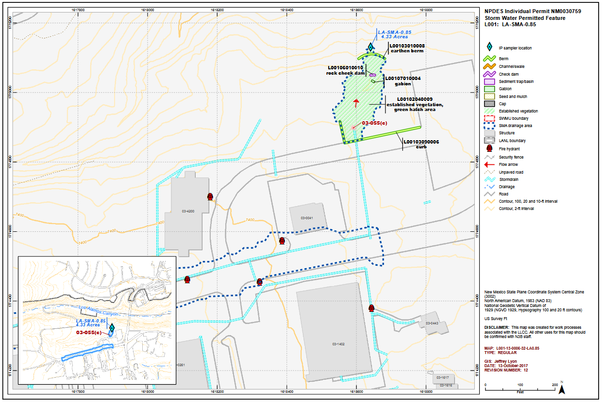
LA-SMA-0.85 Map

Slide 10
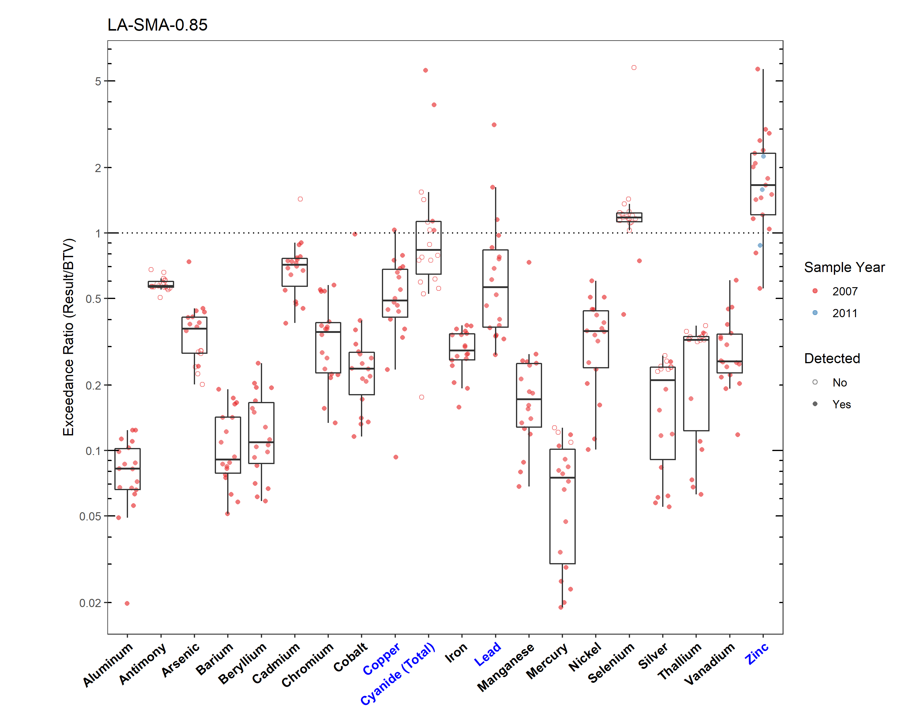
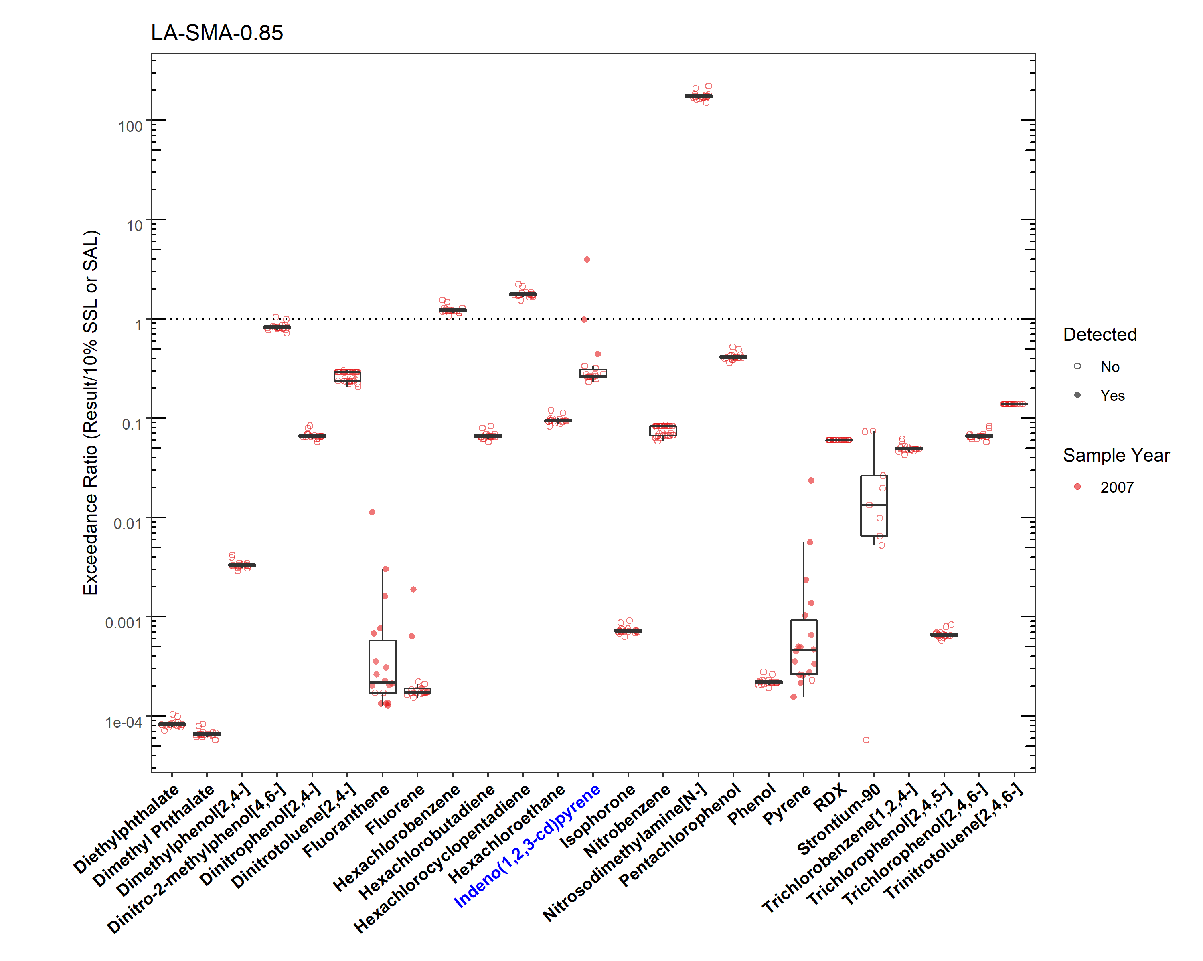
LA-SMA-0.85 Soil Data (pt. 1)
Notes:
Soil screening level for the IP is 10% of the BV or SSL/SAL if there is no BV.

Slide 11
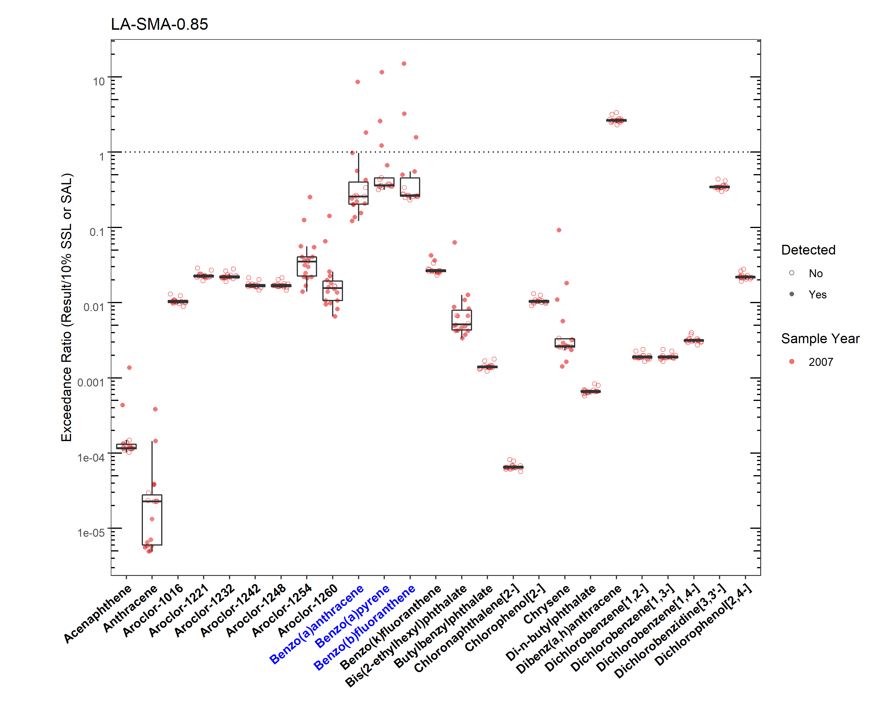
LA-SMA-0.85 Soil Data (pt. 2)
Notes:
Soil screening level for the IP is 10% of the BV or SSL/SAL if there is no BV.

Slide 12
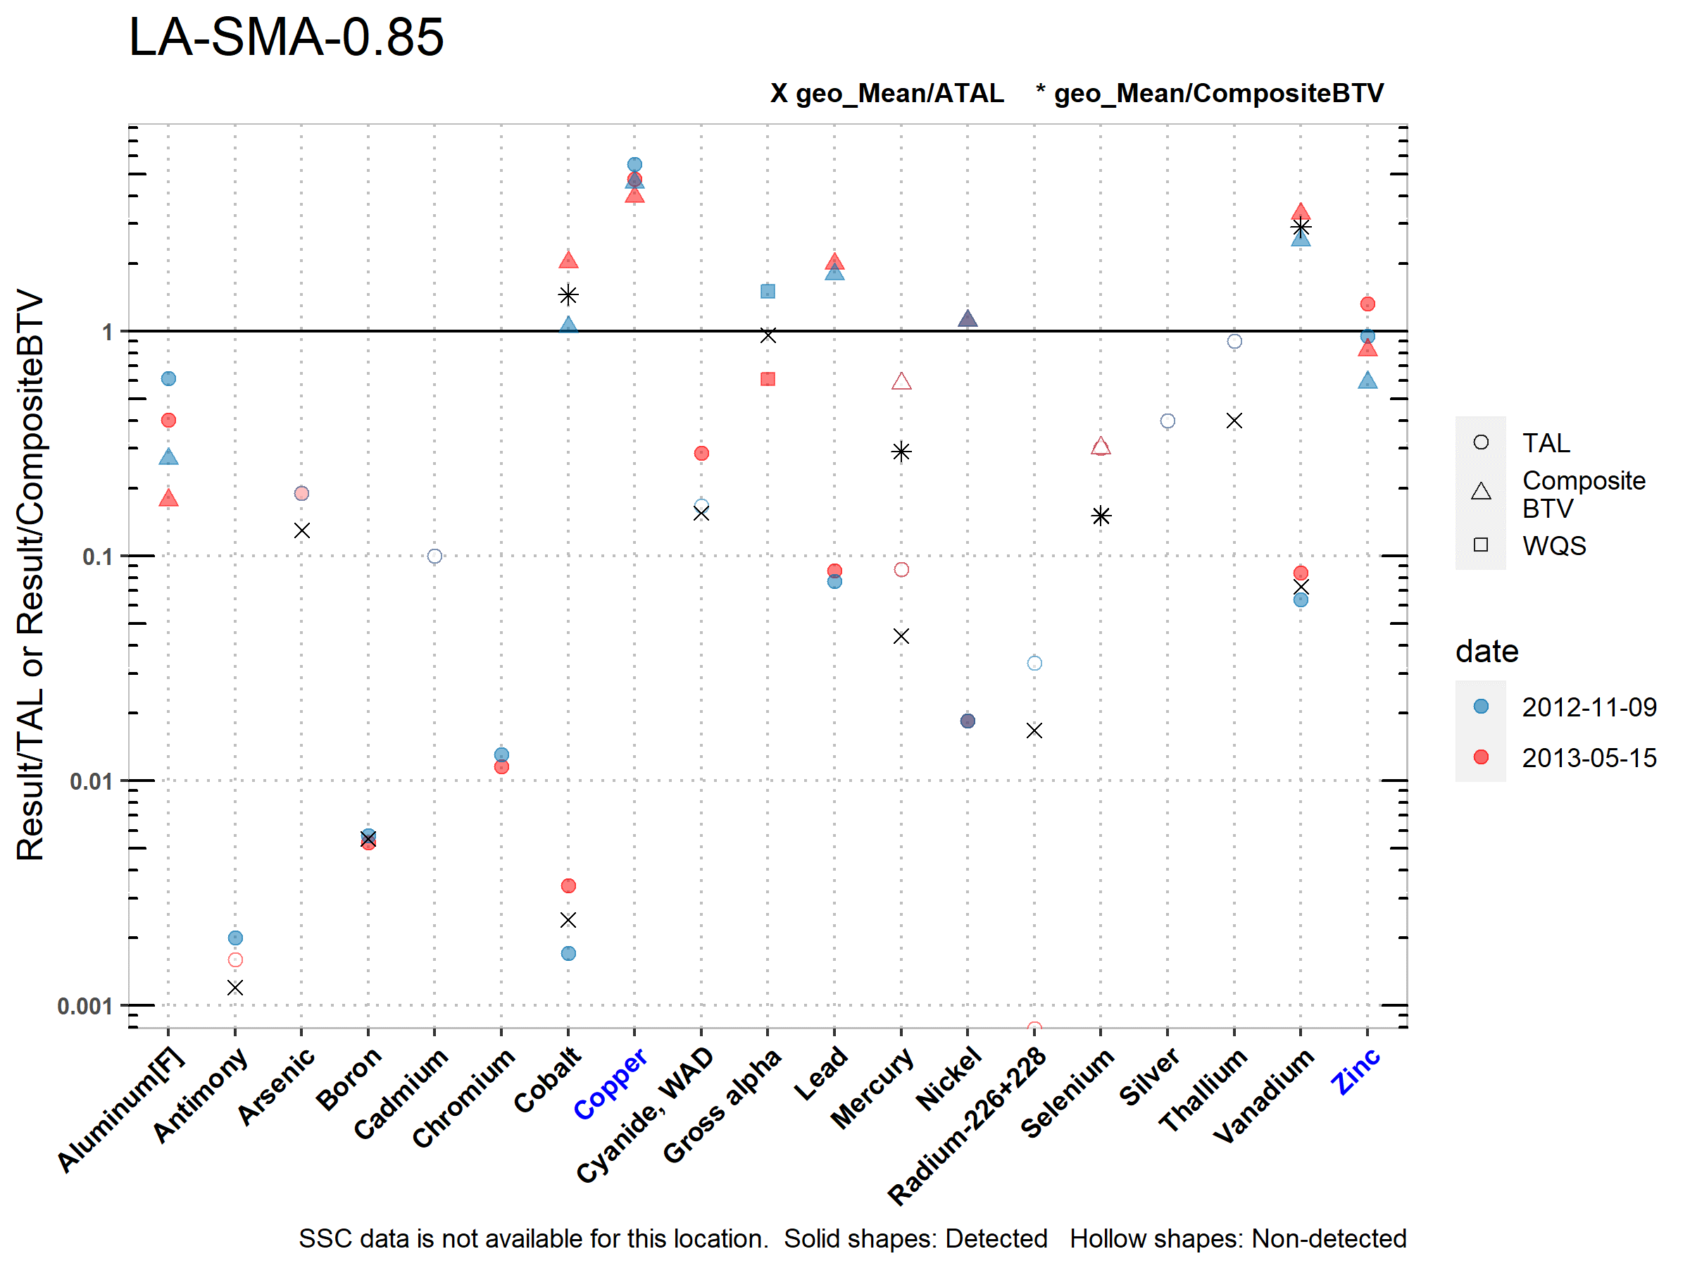
LA-SMA-0.85 Stormwater Data
Copper and Zinc exceeded the TAL and BTV in the storm water samples from 2012 and 2013

Slide 13
SSD for LA-SMA-0.85
SSD Summary:
The following Site-related POCs exceeded the applicable screening value in soil data and have not yet been measured in storm water: benzo(a)anthracene, benzo(a)pyrene, benzo(b)fluoranthene, and indeno(1,2,3-cd)pyrene. They will be added for monitoring.
PCBs were measured in soil data and did not exceed the screening values, but the stream reach is impaired for PCBs and they are Site-related so they will be added for monitoring.
Copper, lead and zinc also exceeded in soil data but they were previously monitored and will not be added for additional monitoring.
Monitoring Constituent | Background for Monitoring
PCBs | Impairment and Site History (organic chemicals)
Semi-Volatile Organic Compounds (SVOCs) | Site History (organic chemicals) and Soil Data
Dissolved Organic Carbon (DOC) | Permit Requirement
Suspended Sediment Concentration (SSC) | Permit Requirement

Slide 14
Questions?
Produced by Los Alamos Legacy Cleanup Contractor, N3B Los Alamos on behalf of DOE’s Environmental Management Los Alamos Field Office

Slide 15
Additional Slides
Produced by Los Alamos Legacy Cleanup Contractor, N3B Los Alamos on behalf of DOE’s Environmental Management Los Alamos Field Office

Slide 16
Long-Term Stewardship Example: CDV-SMA-2.5
Associated Sites | 16-010(c), 16-010(d), 16-028(a)
Receiving Water | Cañon de Valle
Drainage Area | 23.50-acres
Landscape Characteristics | 10% impervious, 90% pervious
Consent Order Site Status | SWMU 16-010(c): No Further Action Approved SWMU 16-010(d): No Further Action Approved SWMU 16-028(a): In Progress
2010 Administratively Continued Permit Final Status | Baseline Confirmation Complete/Site Deletion Request
2016–2018 SIP Actions | Based on the November 2016 field visit, the current sampling location and boundary was agreed upon by all parties to be the best representation of stormwater discharge from 16-028(a). SWMUs 16-010(c) and 16-010(d) were not reviewed in the 2016-2018 SIP process as they have been removed from the LANL Hazardous Waste Facility Permit and are therefore no longer subject to the Consent Order.
2022 Permit Status | Long-Term Stewardship
Notes:
16-010(c) (no date)
SWMU 16-010(c) is a former burn table that was converted to a flash pad/burn tray (structure 16-388) located at the TA 16 Burning Ground. The burn table was used to treat HE scrap. The 100-ft x 100-ft enclosed area consisted of a concrete pad that was used to unload explosives and a 16-ft x 4-ft metal tray that was approximately 2 ft above the ground surface. Scrap HE was placed on the tray and burned. The current flash pad consists of a 22-ft x 22-ft concrete pad set on a secondary containment area and surrounded on three sides by a concrete wall. Before treatment, the HE-contaminated wastes are placed on steel pallets or steel trays.
16-010(d) (no date)
SWMU 16-010(d) is a former burn table that was converted to a burn tray (structure 16-399) located at the TA-16 Burning Ground. The 100 ft² enclosed area consists of a concrete pad, a burn table that is approximately 2 ft above the ground surface, and a 16-ft x 4-ft metal tray situated on the table. Scrap HE is placed on the tray and burned. A metal-covered rain guard can be rolled back to expose the tray.
16-028(a) (2/18/2021)
SWMU 16-028(a) is the south drainage channel that drained the southern half of the Burning Ground at TA-16 Burning Ground. The drainage is associated with SWMUs 16-005(g) and 16-010(h-n), the former filter basket wash facility, and discharges from a carbon filter/treatment unit renumbered from structure 16-228 to 16-363 [SWMU 16-010(g)]. The site provides the only surface water drainage for approximately half the TA-16 Burning Ground, and it marks the southern edge of historical Burning Ground activities.

Slide 17
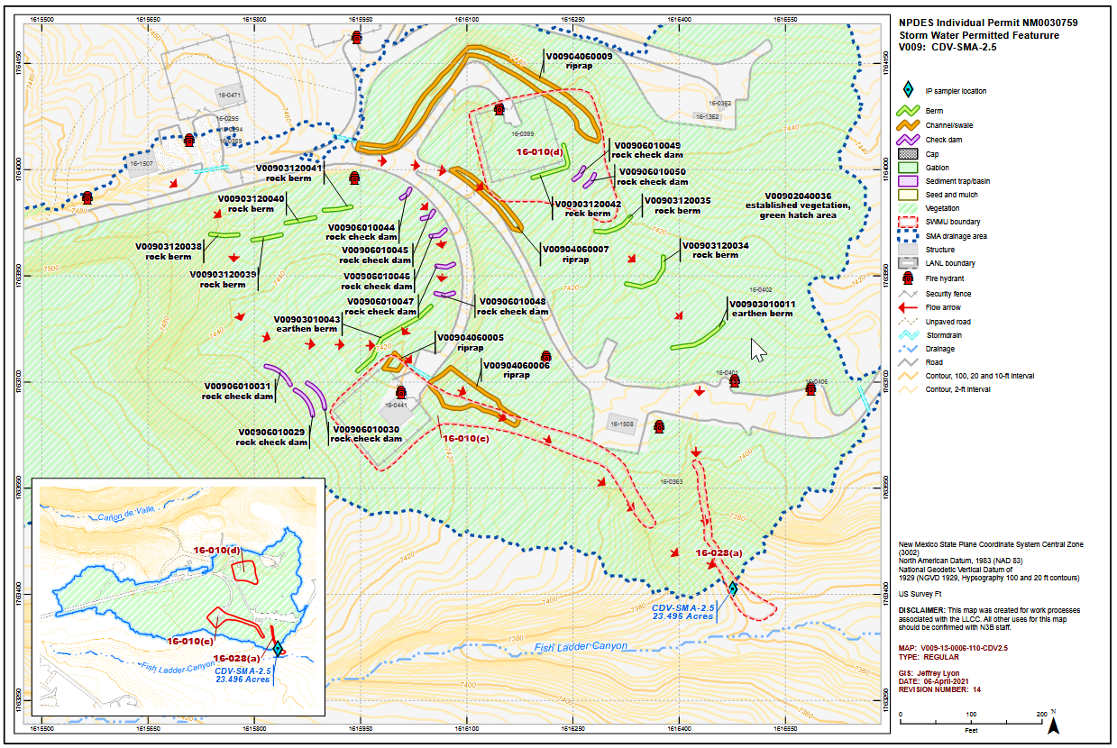
CDV-SMA-2.5

Slide 18
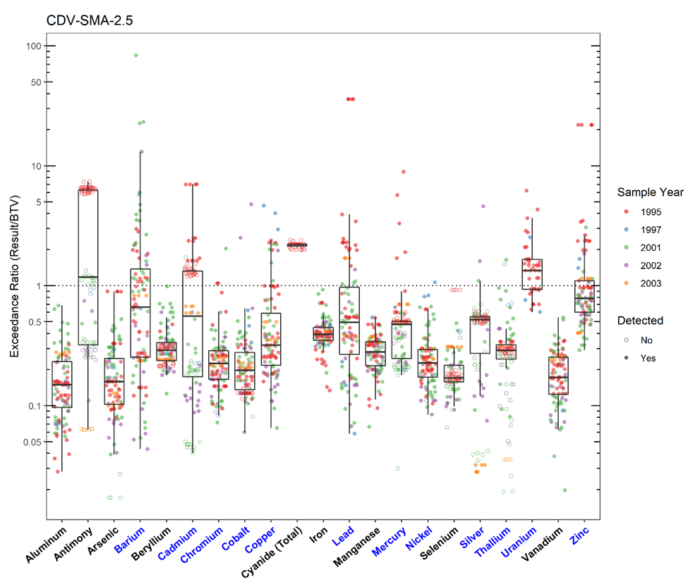
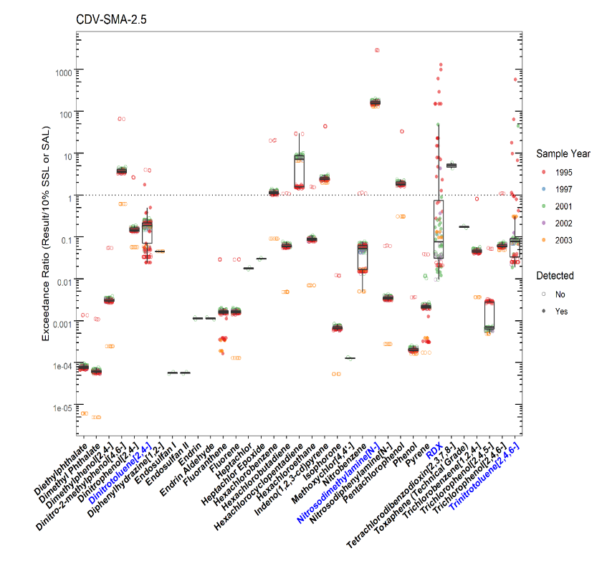
CDV-SMA-2.5 Soil Data (pt. 1)
Notes:
There is no data available for 16-010(c) or 16-010(d). Decision-level data for SWMU 16-028(a) consists of results from samples collected in 1995 and 1997. The 2006 investigation work plan concluded the nature and extent of contamination was not defined and additional sampling is recommended.
Investigations at the Sites monitored by CDV-SMA-2.5 is not complete. Deletion is not an option until soil sampling is completed for all Sites within an SMA.

Slide 19
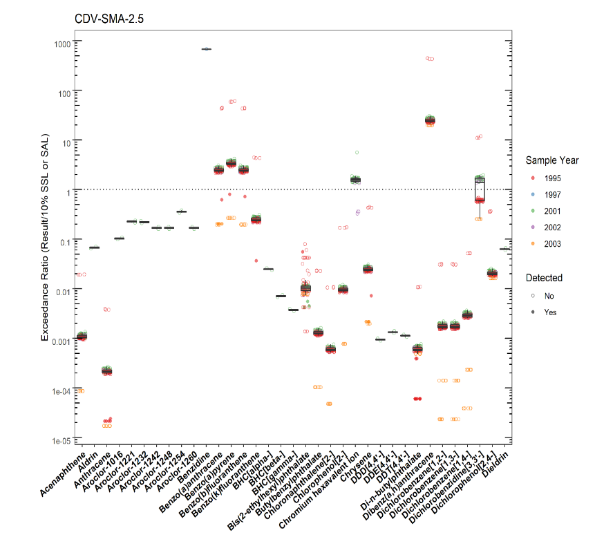
CDV-SMA-2.5 Soil Data (pt. 2)
Notes:
There is no data available for 16-010(c) or 16-010(d). Decision-level data for SWMU 16-028(a) consists of results from samples collected in 1995 and 1997. The 2006 investigation work plan concluded the nature and extent of contamination was not defined and additional sampling is recommended.
Investigations at the Sites monitored by CDV-SMA-2.5 is not complete. Deletion is not an option until soil sampling is completed for all Sites within an SMA.

Slide 20
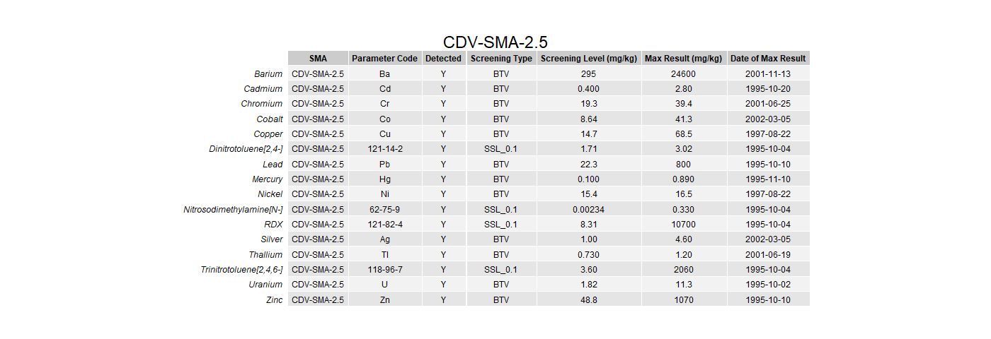
CDV-SMA-2.5 Soil Data (pt. 3)
Notes:
There is no data available for 16-010(c) or 16-010(d). Decision-level data for SWMU 16-028(a) consists of results from samples collected in 1995 and 1997. The 2006 investigation work plan concluded the nature and extent of contamination was not defined and additional sampling is recommended.
Investigations at the Sites monitored by CDV-SMA-2.5 is not complete. Deletion is not an option until soil sampling is completed for all Sites within an SMA.

Slide 21
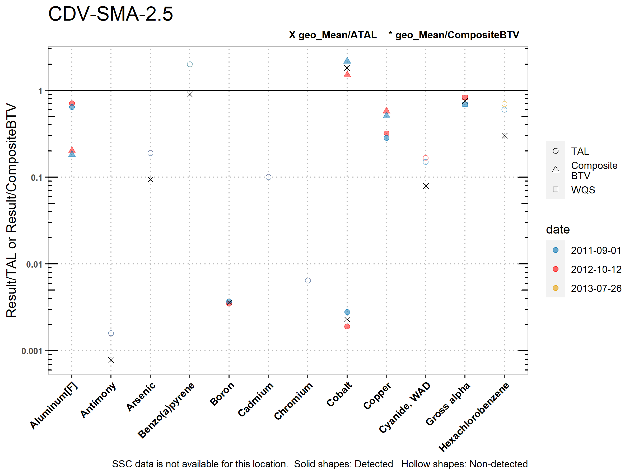
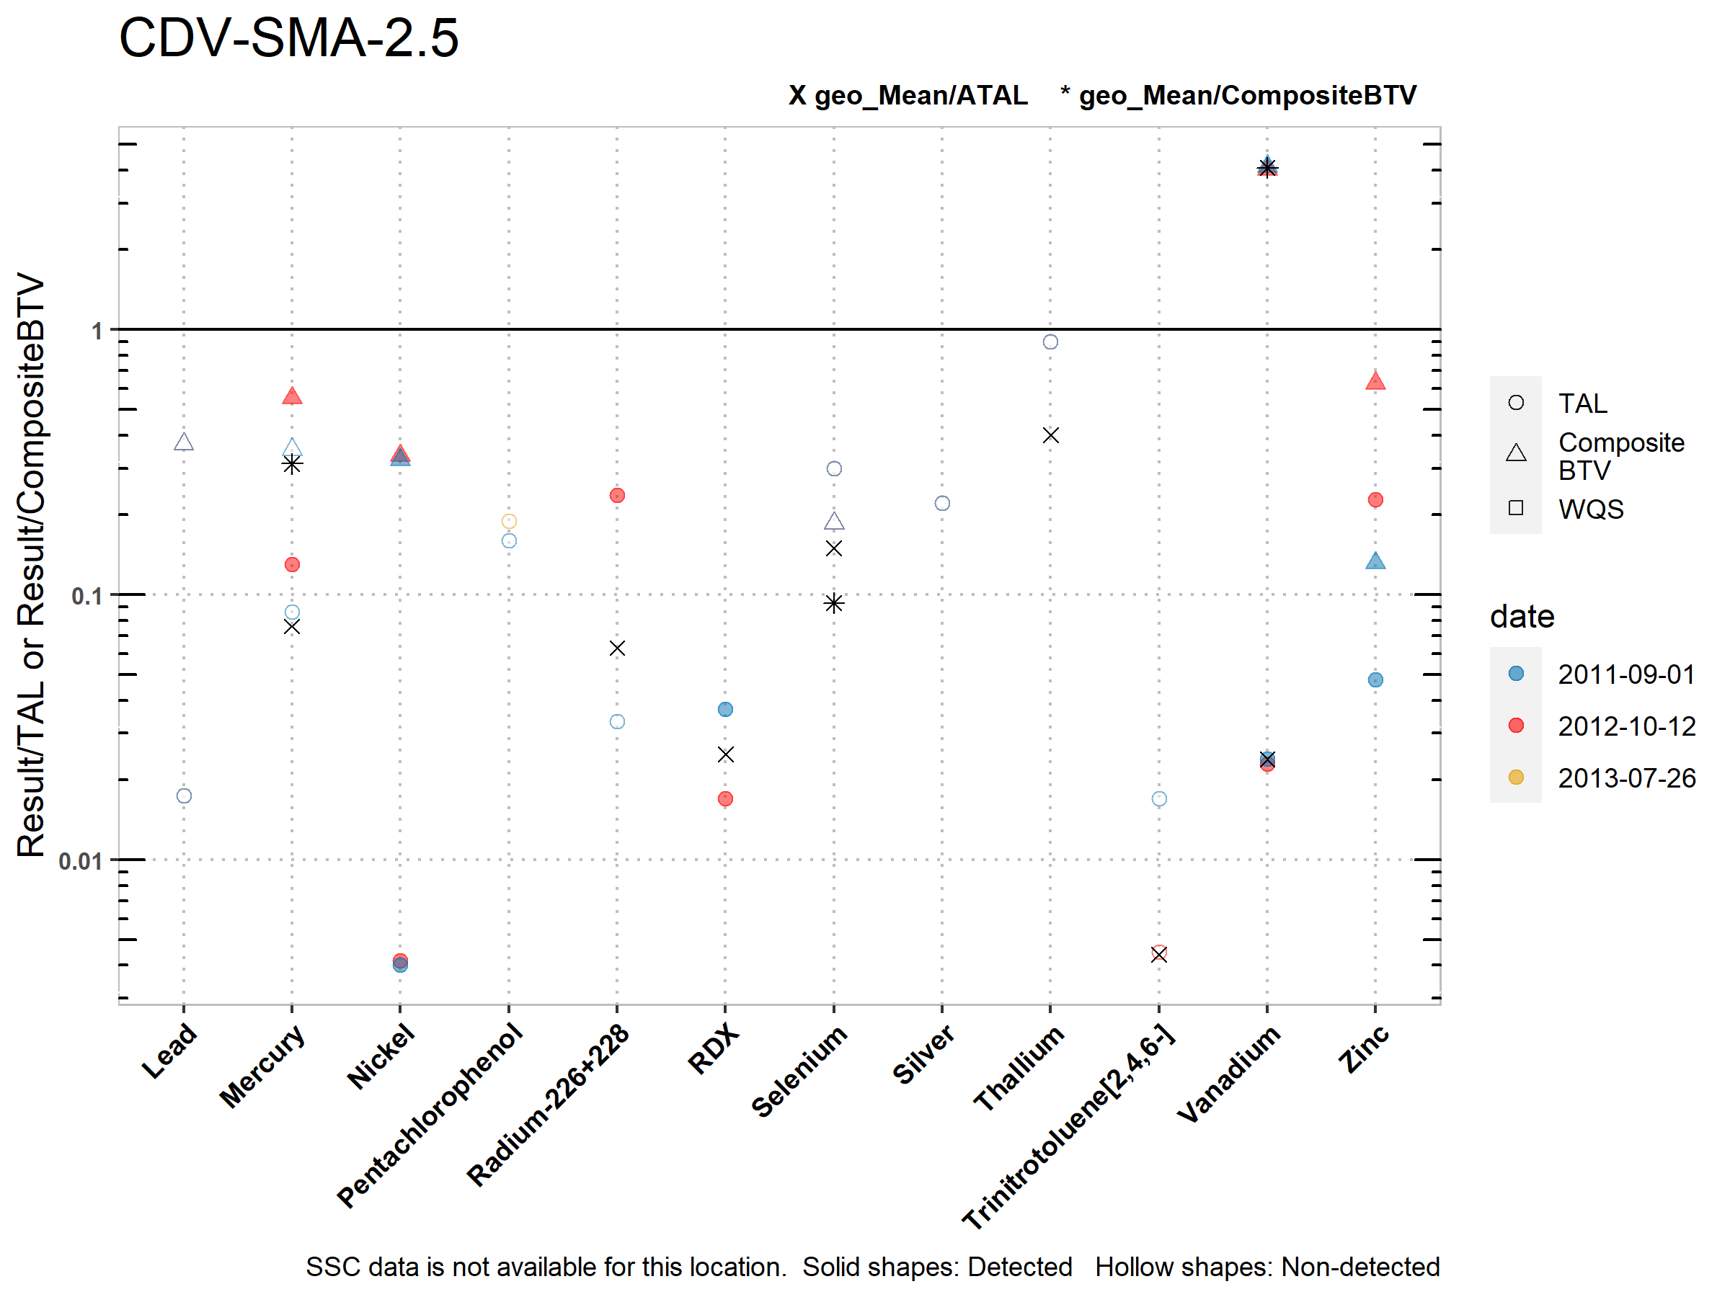
CDV-SMA-2.5 Stormwater Data
No TAL Exceedances

Slide 22
CDV-SMA-2.5 2022 Permit Status
Long-Term Stewardship:
All Site-related POCs that exceeded the applicable screening values in soil data were previously monitored in stormwater data and did not exceed TALs.
No TAL exceedances in confirmation monitoring data.
Soil sampling for the Sites within the SMA is not complete, the Site will be re-screened when soil data is available.

Slide 23
Corrective Action Example: M-SMA-12.9
Associated Sites | 05-001(b), 05-002
Receiving Water | Mortandad Canyon
Drainage Area | 0.17 acres
Landscape Characteristics | 100% pervious
Consent Order Site Status | SWMU 05-001(b): Pending Inclusion in Permit Mod Request. Certificate of Completion Received Without Controls SWMU 05-002: Pending Inclusion in Permit Mod Request. Certificate of Completion Received Without Controls
2010 Administratively Continued Permit Final Status | Corrective Action Complete
2016-2018 SIP Actions | Based on the May 2017 field visit and follow-up field review of the site topography, soil sample locations, and results, the SIP team determined that the current SMA sampler does encompass stormwater from soil sample locations of concern at this Site, and the current location is representative.
2022 Permit Status | Corrective Action
Notes:
05-001(b) (no date)
SWMU 05-001(b) is a former steel barricade firing pit, designated No.2 (structure 05-15). The pit was constructed in 1944 and was taken out of service in 1959. Experimental shots were set up at the site and fired on open ground. As debris accumulated, a bulldozer cleared the pit area by pushing scrap and debris north to the edge of Mortandad Canyon. The shrapnel zone included the canyon sides, canyon bottom, and about 200 ft around the firing pits.
During 1985 D&D activities, the firing pit was removed, and uranium contamination was found in the soil to a depth of 15 ft. The area was decontaminated and backfilled with clean soil.
05-002 (no date)
SWMU 05-002 is a canyon-side disposal site associated with firing pits 1 and 2 [SWMUs 05-001(a) and 05-001(b)]. This Site was used extensively for 3 yr. As debris from experimental shots at the firing pits accumulated, a bulldozer was used to push the debris northward to the edge of Mortandad Canyon. The debris zone extended to the canyon bottom.
Waste potentially disposed of at this Site included shot debris, cables, wire, and trace amounts of lead, uranium, beryllium, cadmium, and uranium-contaminated aluminum or steel. A 1976 radiation study showed contamination. During the 1985 LASCP cleanup effort, all debris present at the Site was removed from SWMU 05-002.

Slide 24
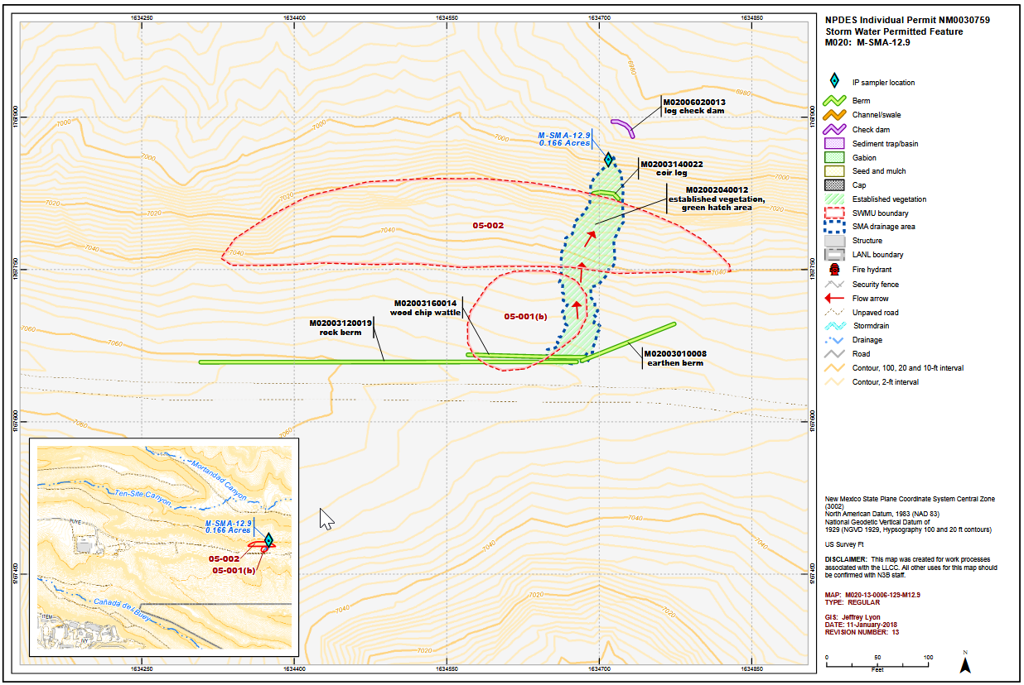
Corrective Action Example: M-SMA-12.9

Slide 25
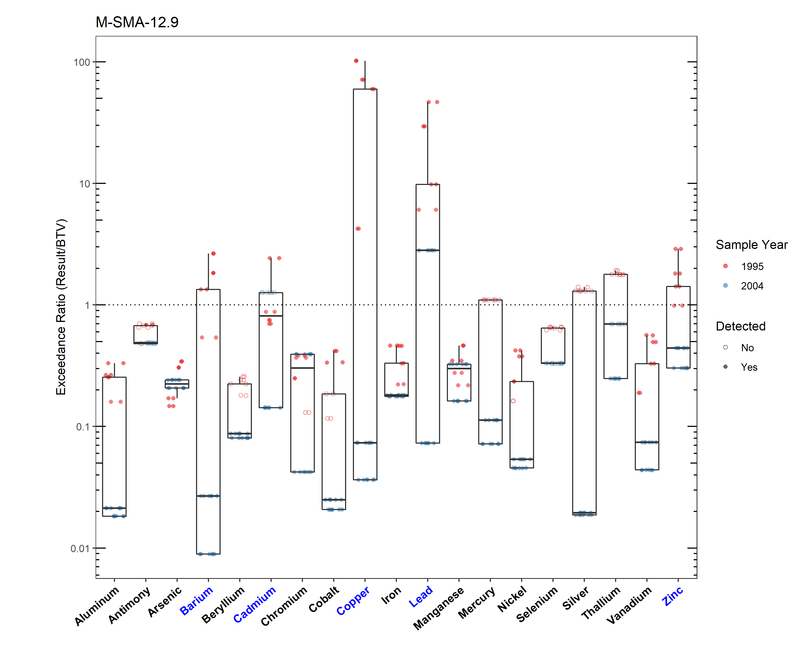
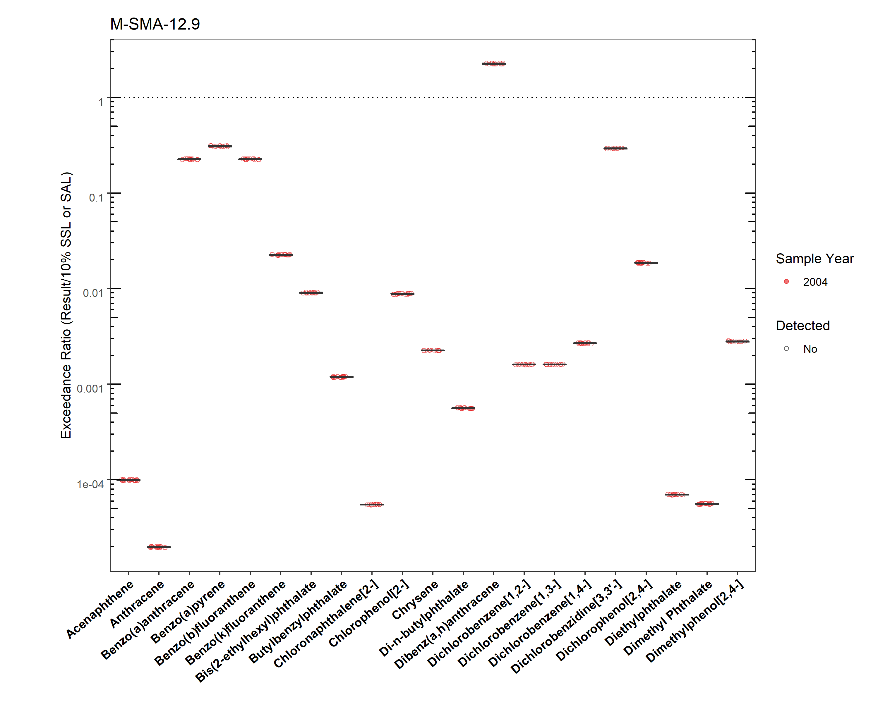
M-SMA-12.9 Soil Data (pt. 1)

Slide 26
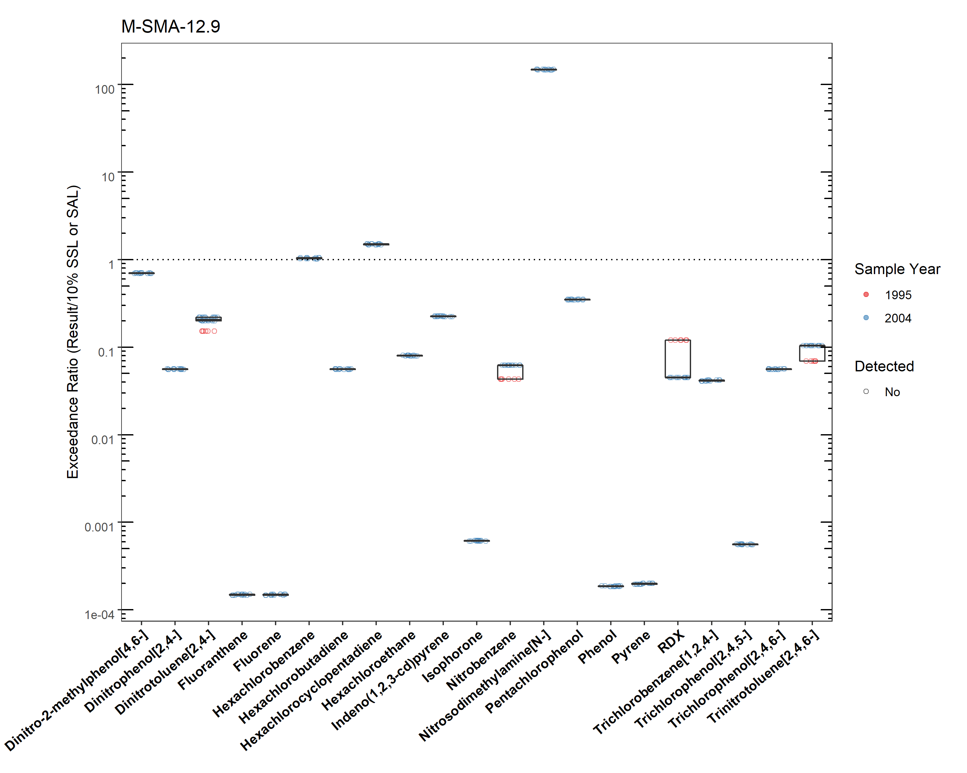
M-SMA-12.9 Soil Data (pt. 2)

Slide 27
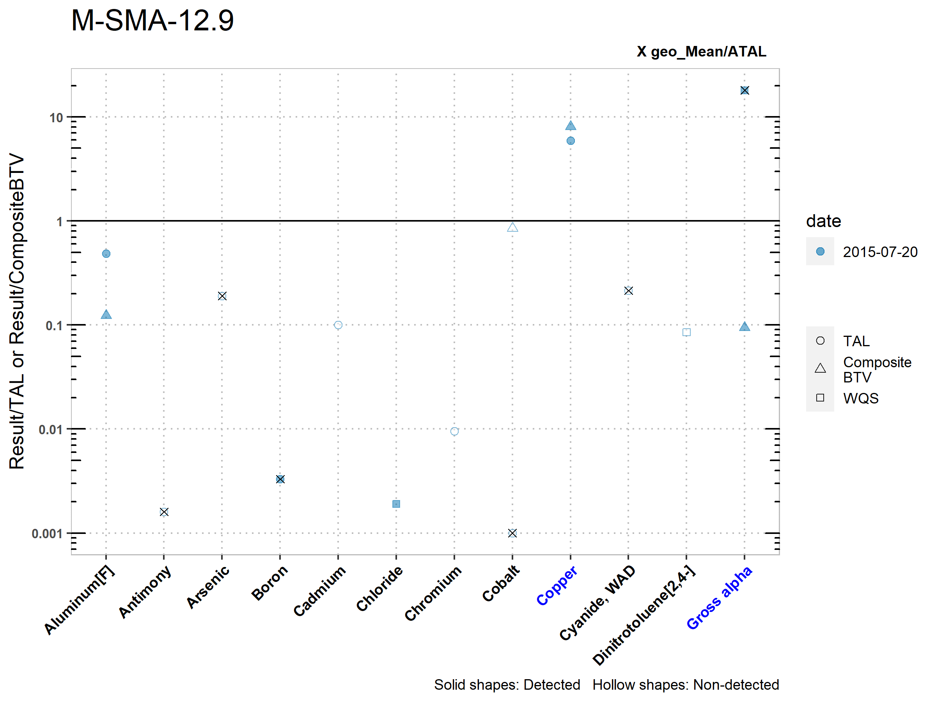
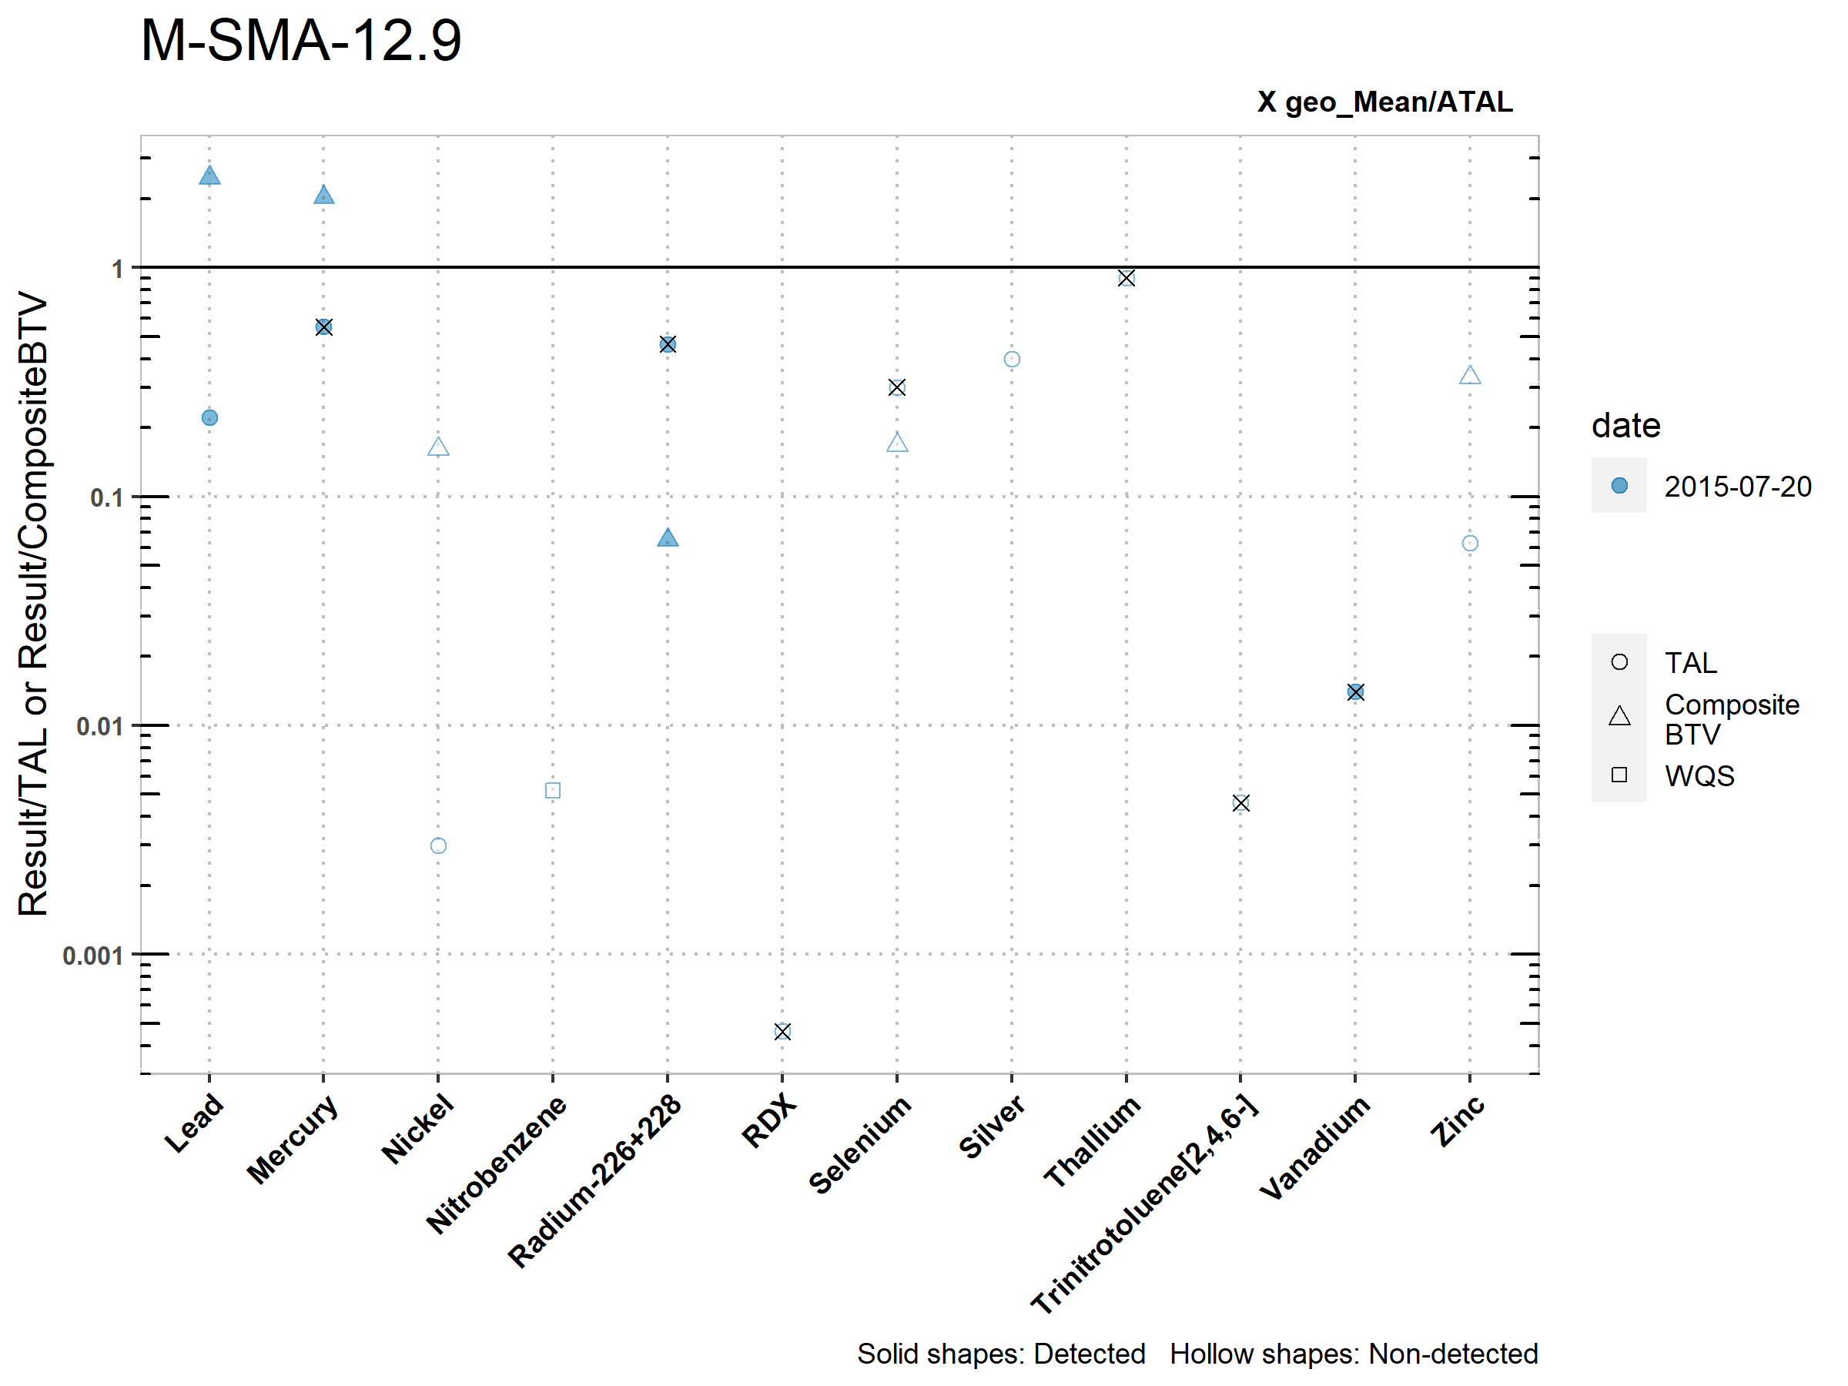
M-SMA-12.9 Stormwater Data
Copper exceeded the TAL and BTV
Gross alpha exceeded the TAL but not the BTV
Notes:
Copper exceeded the TAL and BTV initiating corrective action.

Slide 28
M-SMA-12.9 2022 Permit Status
Corrective Action:
Due to receipt of COCs from NMED under the Consent Order this SMA was in Corrective Action Complete status under the 2010 Permit. However, that is no longer a compliance pathway under the 2022 Permit and the SMA was reevaluated.
Barium exceeded the applicable screening value in soil data but is not a Site-related POC. Therefore, it will not be added for monitoring. Copper exceeded the applicable screening value in soil and exceeded the TAL in stormwater. The remaining metals that exceeded the applicable screening value in soil data were previously measured in stormwater data and did not exceed TALs.
Gross alpha exceeded the TAL but not the BTV. Copper exceeded the TAL and BTV, initiating corrective action.

