Slide 1
Individual Permit for Storm Water at Los Alamos National Laboratory
Amanda White
Deputy Director for Water Programs & Program Manager for Compliance Monitoring and Technical Services
November 9, 2022

Slide 2
Today’s Topics
What is a Storm Water Permit?
Objectives of Permit
FY22 Work Under Previous Permit
New Permit and Changes

Slide 3
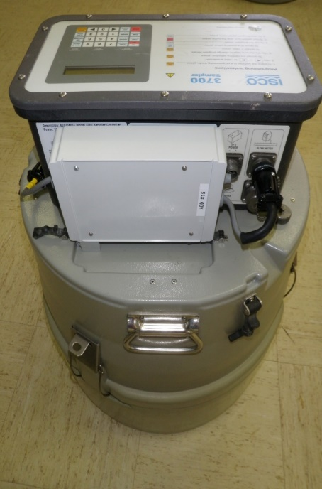
What is a Storm Water Permit?
Storm water permits authorize permittees to discharge storm water from specific activities or facilities
Part of the National Pollutant Discharge Elimination System (NPDES), the permitting program to protect and improve water quality
NPDES is part of the Federal Clean Water Act administered by the U.S. Environmental Protection Agency (EPA)
Individual storm water permit is a type of NPDES permit
Permit need is determined by EPA and requirements are specific to a particular facility or activity
Individual storm water permits are issued by EPA for a maximum of 5 years

Slide 4
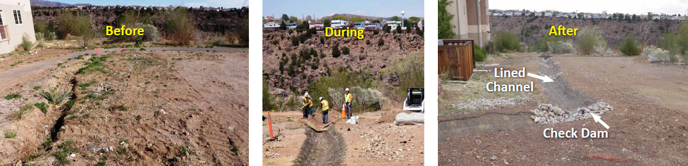
Storm Water Monitoring Objectives
Minimize pollutants of concern (POCs) in storm water runoff from sites potentially contaminated by historical activities at Los Alamos National Laboratory (LANL).
Reducing pollutants in storm water means reducing or eliminating them with storm water control measures, such as earthen berms or rock check dams that detain the sediment to which contaminants typically bind.
Installation of storm water control measures must be followed by comparison of storm water runoff sample results to screening levels, which assesses the effectiveness of the control measure and helps improve water quality.
Installation of storm water controls at P-SMA-2.2

Slide 5
How Do We Monitor Storm Water Runoff?
Storm water runoff
Drainage boundary, or Site Monitoring Area (SMA)
Storm water run-on control
Storm water run-on control
SWMU
Solid Waste Management Unit (SWMU)
SWMU
Solid Waste Management Unit (SWMU)
Storm water runoff controls
Storm water runoff controls
Sampler

Slide 6
IP Site Monitoring Areas (SMAs) across LANL
6
239 SMAs on new permit

Slide 7
Overview of 2022 Work
Operation of 139 IP storm water samplers and 15 rain gages
Conducted:
  1,045 IP storm water sampler inspections
  875 post-storm inspections of storm water control measures
  378 soil disturbance inspections (construction related)
  213 rain gage inspections
  24 Target Action Level (TAL) exceedance inspections
Built 22 small-scale storm water controls in Ancho, Pajarito, Chaquehui, and Water canyons; for reference, over 2,000 IP storm water controls are inspected and maintained at LANL
Collected 27 IP samples and began screening per the new Individual Permit on September 26, 2022; results will be covered in the 2023 Sampling Implementation Plan (SIP)
Began deactivating samplers for winter to avoid sampling snowmelt (not allowed in storm water permits) on October 25, 2022

Slide 8
Storm Water Control-Related Changes to Permit
Quicker timeline for repairing storm water control measures: No later than 7 days after the issue is discovered or as soon as feasible.
New corrective action pathway: Installation of storm water control measures large enough to hold storm water runoff from a storm that (statistically speaking) can occur every 3 years and last for 24 hours.
Higher rainfall intensity threshold for storm water control measure inspections: Improves usefulness and efficiency of inspections (0.25” of rainfall to 0.5” in 30 minutes).
Specific timeline for installing storm water control measures: As soon as practicable, but no later than 24 months from when Permittees have screened storm water results.
August 1, 2022: New permit became effective
September 8, 2022: Minor modifications to permit (to correct references)

Slide 9
Monitoring-Related Changes to Permit
Analysis of partial samples: avoids the rejection of hard-to-obtain storm water samples.
IP Annual Report will be incorporated SDPPP: Stormwater Discharge Pollution Prevention Plan (SDPPP) to remove duplication.
New Target Action Level (TALs) were added: Including the most up-to-date hardness-based TALs, to expand monitoring to include Site-related POCs.
If a Site drains to a surface water that is considered impaired and the chemical it is impaired for is Site-related, the POC it is impaired for will be analyzed in storm water samples.
If a water quality standard exists for a Site-related POC: results will be compared to that standard.
More thorough storm water results screening: Site-Specific Demonstration versus simple TAL screening.
More current monitoring requirements: using an annually-changing Sampling Implementation Plan (SIP) versus a set monitoring suite for 5 years.

Slide 10
Questions?
Produced by Los Alamos Legacy Cleanup Contractor, N3B Los Alamos on behalf of DOE’s Environmental Management Los Alamos Field Office

Slide 11
Initial Sampling Implementation Plan (SIP) Timeline
October 13, 2022 – a draft SIP was submitted to New Mexico Environment Department-Surface Water Quality Bureau.
November 30, 2022 – NMED to provide written comments.
December 30, 2022
  Permittees to provide written response to NMED comments and revise the draft SIP (to include NMED comments and Permittees’ response to those comments).
  Permittees to provide public notice of 30-day public review of the draft SIP.
January 30, 2023 - Public comment period ends. Permittees to modify the draft SIP as appropriate in response to public comments.
March 1, 2023 (but no later than March 31) - Permittees to submit the draft SIP (along with the Permittees’ responses to any public comments received) to EPA for approval with a copy provided to NMED.
April 1, 2023 - EPA will review proposed SIP, require revisions as necessary, and approve as a minor permit modification. Note: unless disapproved, Permittees may implement proposed SIP 30 days after submittal to EPA and update as necessary once the final SIP is approved.

Slide 12
Annual Updates to SIP
January 15 – Permittees to send draft SIP updates to NMED.
February 15 – NMED to review and provide comments on draft SIP updates.
March 31 – Draft SIP due to EPA
  Permittees will revise draft SIP updates based on NMED’s input.
  Permittees will submit draft SIP updates to EPA for review and approval. Note: if no comments are received from NMED by February 15, Permittees may submit the draft SIP updates to EPA for approval without NMED input.
April 31 – EPA will review proposed SIP updates, require revisions as necessary, and approve as a minor permit modification. Note: unless disapproved, Permittees may implement proposed SIP 30 days after submittal to EPA and update as necessary once the final SIP is approved.
Please note – there is no public comment period for annual updates to the SIP, only the initial SIP. The initial SIP is the foundational document to establish monitoring suites and all updates will use the same process.

Slide 13
Hardness-based TALs in line with NM Water Quality Standards
Major Canyon | Dissolved Hardness (mg/L) | Total Recoverable Aluminum* (µg/L) | Dissolved Cadmium (µg/L) | Dissolved Chromium III (µg/L) | Dissolved Copper (µg/L) | Dissolved Lead (µg/L) | Dissolved Nickel (µg/L) | Dissolved Silver (µg/L) | Dissolved Zinc (µg/L)
Ancho | 37.2 | 883 | 0.711 | 253 | 5.29 | 21.7 | 203 | 0.587 | 65.1
Chaquehui | 26.9 | 566 | 0.539 | 194 | 3.90 | 15.1 | 154 | 0.336 | 48.5
Los Alamos/Pueblo | 33.5 | 765 | 0.650 | 233 | 4.80 | 19.3 | 186 | 0.490 | 59.2
Mortandad | 29.5 | 643 | 0.583 | 210 | 4.25 | 16.7 | 167 | 0.394 | 52.7
Pajarito | 30.2 | 664 | 0.595 | 214 | 4.35 | 17.2 | 170 | 0.410 | 53.9
Sandia | 43.0 | 1077 | 0.804 | 285 | 6.07 | 25.5 | 229 | 0.753 | 74.3
Water/Cañon de Valle | 47.7 | 1241 | 0.879 | 311 | 6.69 | 28.6 | 250 | 0.900 | 81.6
  * Filter total recoverable aluminum sample with a 10-μm filter prior to acidification

Slide 14
TALs to be Added to the Permit
Pollutant | Chemical Abstracts Service (CAS) Number | Minimum Quantification Level (MQL) ug/L | Average Target Action Level (ATAL) (chronic value) ug/L | Maximum Target Action Level (MTAL) (acute value) ug/L
Antimony, dissolved | 7440-36-0 | 1.00 |  | 640
Anthracene | 120-12-7 | 0.064 |  | 40,000
Benzo(a)anthracene | 56-55-3 | 0.064 |  | 0.18
Benzo(a)pyrene | 50-32-8 | 0.064 |  | 0.18
Benzo(b)fluoranthene | 205-99-2 | 0.064 |  | 0.18
Benzo(k)fluoranthene | 207-08-9 | 0.064 |  | 0.18
Bis (2-ethylhexyl) phthalate | 117-81-7 | 0.355 |  | 22
Butylbenzylphthalate | 85-68-7 | 0.355 |  | 1,900
Chrysene | 218-01-9 | 0.064 |  | 0.18
Dibenzo(a,h)anthracene | 53-70-3 | 0.064 |  | 0.18
Diethylphthalate | 84-66-2 | 0.355 |  | 44,000
Dimethylphthalate | 131-11-3 | 0.355 |  | 1,100,000
Fluorene | 86-73-7 | 0.064 |  | 5,300
Fluoranthene | 206-44-0 | 0.064 |  | 140
Indeno-1,2,3-cd-pyrene | 193-39-5 | 0.064 |  | 0.18
Phenol | 108-95-2 | 3.55 |  | 860,000
Pyrene | 129-00-0 | 0.064 |  | 4,000
Strontium-90 |  |  |  | 3.5 pCi/L
Hexavalent chromium* | 18540-29-9 | 0.155 | 11 | 16
* According to the analytical method, hexavalent chromium needs to be preserved immediately upon collection, which is not possible for automated samplers. Therefore, Permittees will collect samples for hexavalent chromium and report the time between collection and preservation.

