Slide 1
Communities for clean water
LANL Stormwater IP
11-30-2021 Public Meeting
Rachel Conn – CCW and Amigos Bravos

Slide 2
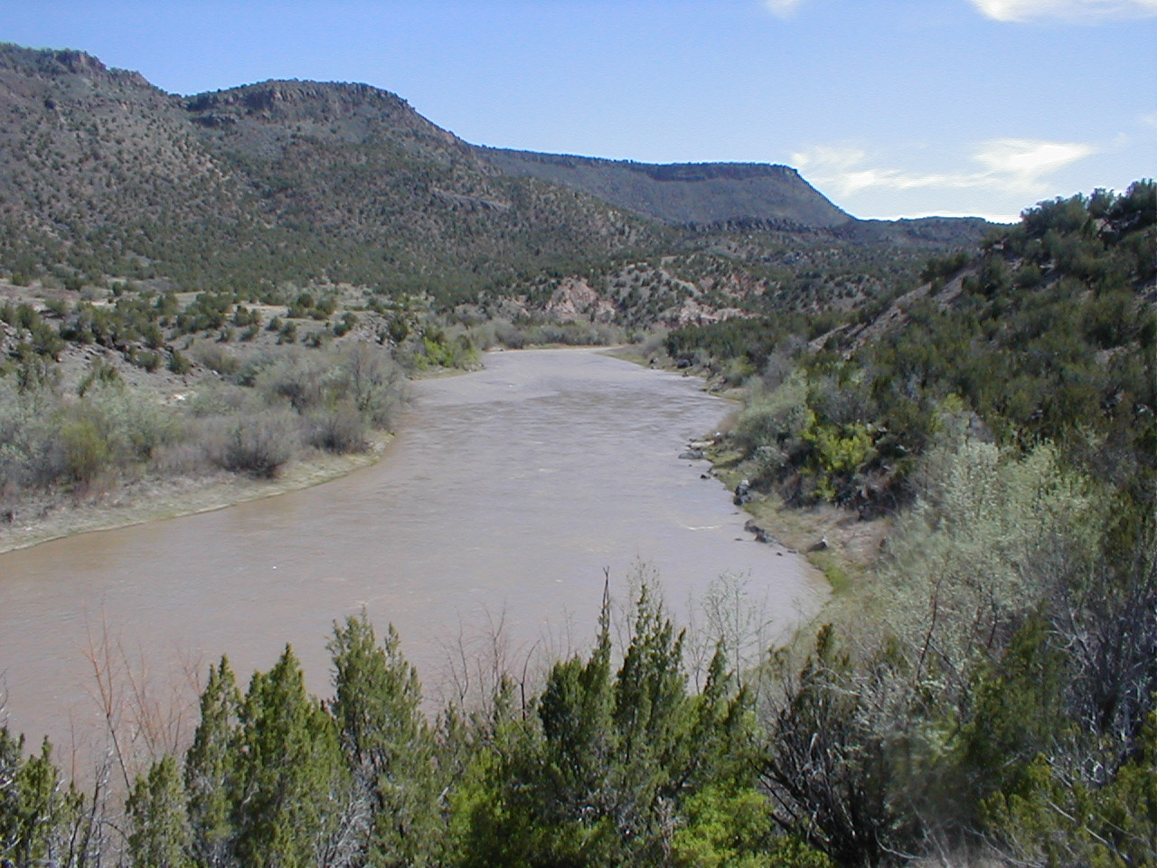
CCW Blessing
Everyone here walks, lives, and breathes within these sacred lands of Tewa Peoples. As we begin our activities, let us fully acknowledge where we are and give thanks for living mountains, valleys and waters, which sustain our lives and form Tewa ancestral homelands and those of land-based Peoples. Let us ground our activities in awareness of where we are and may the mannerism of Tewa Peoples enter our lives and fill us with gratitude, love, care, and respect for all that is shared between us and all beings.

Slide 3
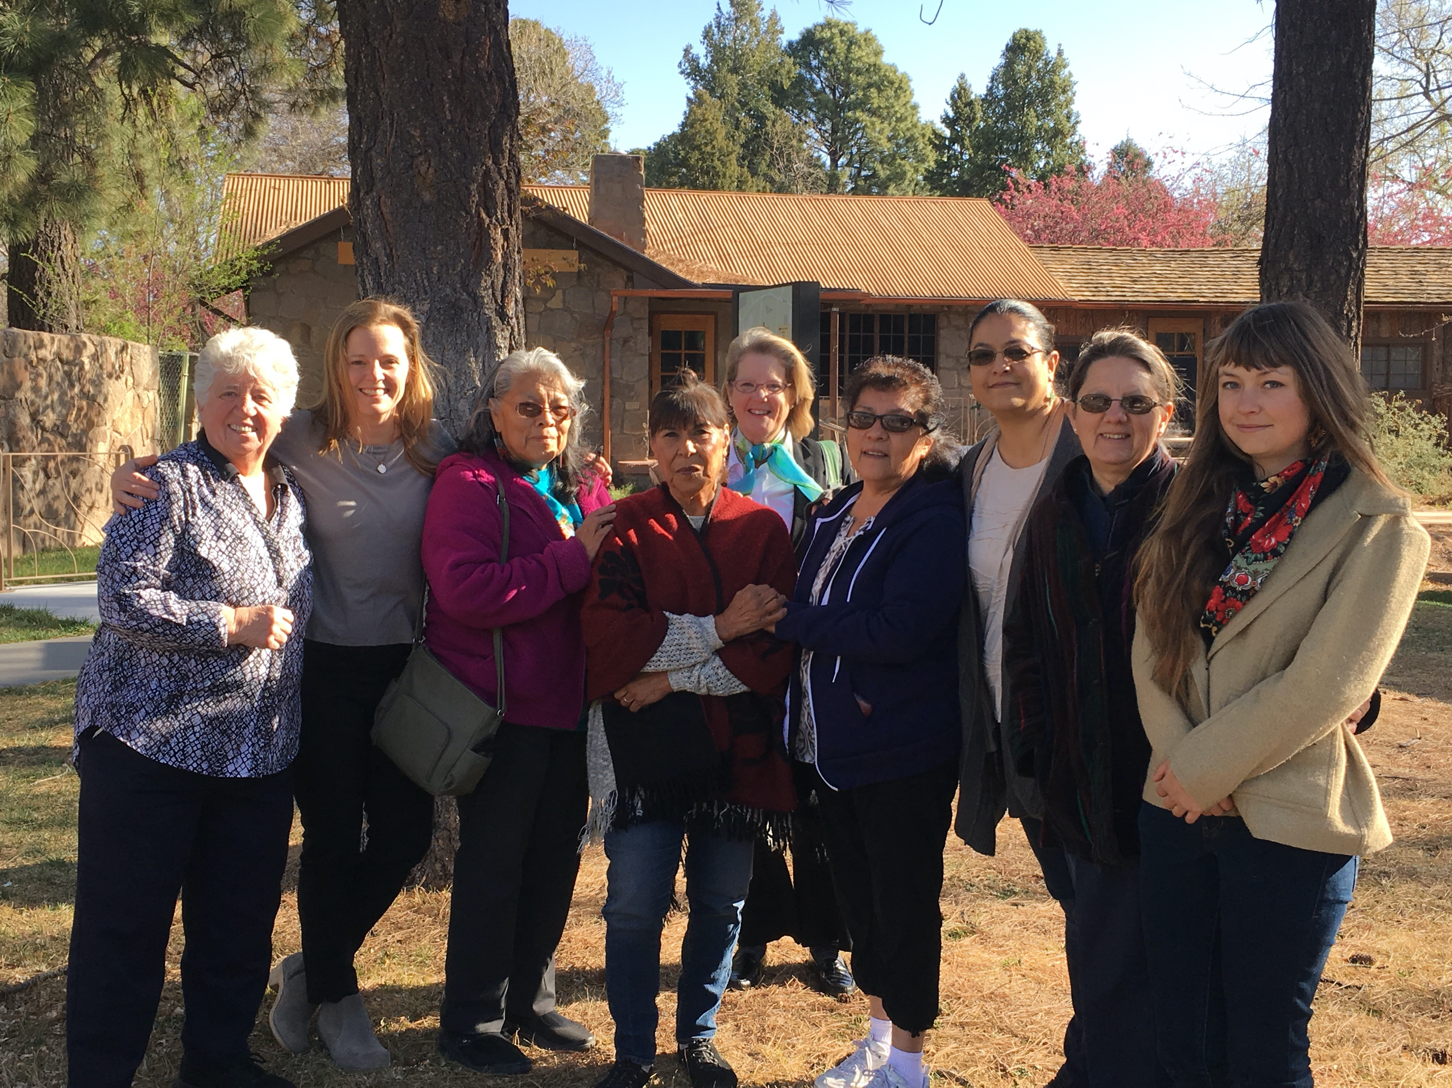
About CCW
Communities for Clean Water is a coalition of individuals and organizations rooted in a variety of traditions. Our growing coalition includes Tewa Women United, Concerned Citizens for Nuclear Safety (CCNS), Amigos Bravos, Honor Our Pueblo Existence (HOPE), the New Mexico Acequia Association, and the Partnership for Earth Spirituality.
CCW’s mission is to ensure that community waters impacted by Los Alamos National Laboratory (LANL) are kept safe for drinking, agriculture, sacred ceremonies, and a sustainable future.
CCW member groups share in common an awareness that caring for clean water and the Rio Grande is a moral and ethical responsibility.

Slide 4
Stormwater Renewal process
CCW remains committed to encouraging a permit that supports the following:
Construction of stormwater-quality control measures (BMPs) to mitigate the risk of polluted runoff leaving LANL property.
Ensuring long term stewardship & maintenance of controls.
Encouragement of treatment-oriented practices that go beyond retention.

Slide 5
Triennial Review
CCW is concerned about LANL’s proposals in the Triennial Review of New Mexico’s Water Quality Standards and their implications for the Stormwater Permit, including:
LANL proposal to limit testing methods to only Part 136 methods – this means that only Aroclor method would be allow (congener method would not be allowed).
Proposal to weaken the definition of Toxic Pollutants and thus the ability of the state and EPA to regulate toxics.

Slide 6
LANL Appeal of the 401 Cert
LANL is appealing all 10 of the New Mexico Environment Department’s permit conditions:
Condition 1 requires the Site Discharge Pollution Prevention Plan (“SDPPP”) to “include a demonstration of BMP effectiveness . . . and make a conclusion each year as to whether the BMP’s’ effectiveness is working to protect receiving waters.”
Condition 2 requires the use of Congener Method (Method 1668) for PCB sampling.
Condition 3 requires requires N3B/DOE to “consult with NMED prior to sending Sampling Implementation Plan (“SIP”) updates to EPA for approval;” the SIP to “be publicly noticed for 30 days;” and EPA to “add an approval process for proposed SIP changes to monitoring locations (beyond small location changes needed to address erosion) or constituent suite additions.”
Condition 4 requires the addition of Target Action Levels (“TALs”) for specified contaminants at sites “based on additional information.”

Slide 7
LANL Appeal of the 401 Cert
Condition 5 requires “that Part I.B.1.c (Collection of Partial Samples) prioritize constituents where there is a TMDL in place or a §303(d) listing for a pollutant in the receiving waterbody” and “if there are constituents added during the SIP process that were not collected during the previous permit term, those constituents shall also be prioritized in the event a partial sample is collected.”
Condition 6 requires additional monitoring requirements if specific contaminants are noted as being site-related pollutants of concern according to the SIP documentation. Condition applies to 20 contaminants including Barium, Strontium -90, PFOA and PFAS, and Chromium.
Condition 7 requires additional evaluation and documentation of sites being proposed for deletion from the permit by EPA.
Condition 8 requires additional sites be added to the permit based on documentation provided by NMED.
Condition 9 requires LANL to provide notification of no-exposure certification to any future MS4 permittees.
Condition 10 requires that there be a TAL for adjusted gross alpha.

