Slide 1
Individual Permit Corrective Actions Update
March 4, 2026
Grayson Vogel
Water Programs Deputy Director

Slide 2
Presentation Outline
Acronyms
Individual Permit NM0030759 Corrective Actions
Corrective Actions Completed in 2025
Corrective Actions Scheduled for Completion in 2026

Slide 3
Acronyms
2M – Twomile Canyon
3M – Threemile Canyon
A – Ancho Canyon
Acid – Acid Canyon
AOC – Area of Concern
B – Bayo Canyon
BTV – Background Threshold Value
CDB – Cañada del Buey
CDV – Cañon de Valle
CHQ – Chaquehui Canyon
DP – DP Canyon
IP – Individual Permit
LA – Los Alamos Canyon
LANL – Los Alamos National Laboratory
M – Mortandad Canyon
NPDES – National Pollutant Discharge Elimination System
P – Pueblo Canyon
PCB – Polychlorinated biphenyl
POC – Pollutant of Concern
PJ – Pajarito Canyon
PT – Potrillo Canyon
R – Rendija Canyon
S – Sandia Canyon
SMA – Site Monitoring Area
STRM - Starmers Gulch
SWMU – Solid Waste Management Unit
T – Ten Site Canyon
TA – Technical Area
TAL – Target Action Level
W – Water Canyon

Slide 4
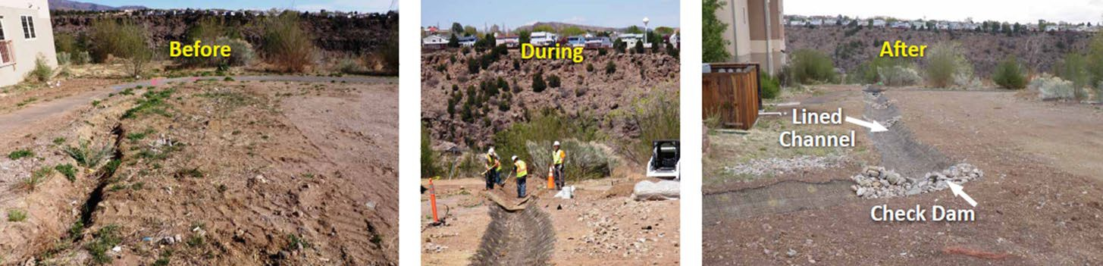
Individual Permit NM0030759 Corrective Actions
Individual Permit (IP) effective date: August 1, 2022
The IP requires stormwater discharge monitoring of Solid Waste Management Units (SWMUs), and Areas of Concern (AOCs) associated with historical industrial activities at Los Alamos National Laboratory (LANL). Examples of monitored SWMUs and AOCs (or Sites) include drain outfalls, septic systems, firing sites, and landfills.
Corrective action is required once a permit Target Action Level (TAL) and Background Threshold Value (BTV) have been exceeded for a Site-related Pollutant of Concern (POC) in a stormwater sample. Examples of POCs include copper, aluminum, polychlorinated biphenyls (PCBs), and silver. All TALs and BTVs are screened to the 2022 IP, even if they were measured before the current IP came into effect. TALs and BTVs are compared to the sample results for a POC to determine the exceedance ratio, which helps size the corrective actions.
Installation of stormwater controls as a corrective action at P-SMA-2.2 in 2011

Slide 5
Individual Permit NM0030759 Corrective Actions
Options for implementing corrective action are:
Installation of Enhanced Controls – Enhanced controls are designed to reduce stormwater run-on or runoff from the Site, mitigate erosion within the Site, or capture sediment/POCs on the Site. Examples include diversion berms, sediment basins, rock check dams, coir logs, compost logs, and established vegetation.
Elimination of Exposure of POCs to stormwater – No exposure can be (a) a cap or engineered cover, or (b) soil removal. Examples include shotcrete and rock caps.
Retention of 3-Year, 24-Hour Storm Runoff Volume – 3-year, 24-hour retention can be achieved by retaining the volume of stormwater runoff from a Site or Site Monitoring Area (SMA) that is equivalent to a 3-year, 24-hour storm event. Examples include a retention berm or retention basin.
If enhanced controls are installed, the site is then monitored to assess the effectiveness of those controls; additional corrective actions are implemented as required based on subsequent sample results.

Slide 6
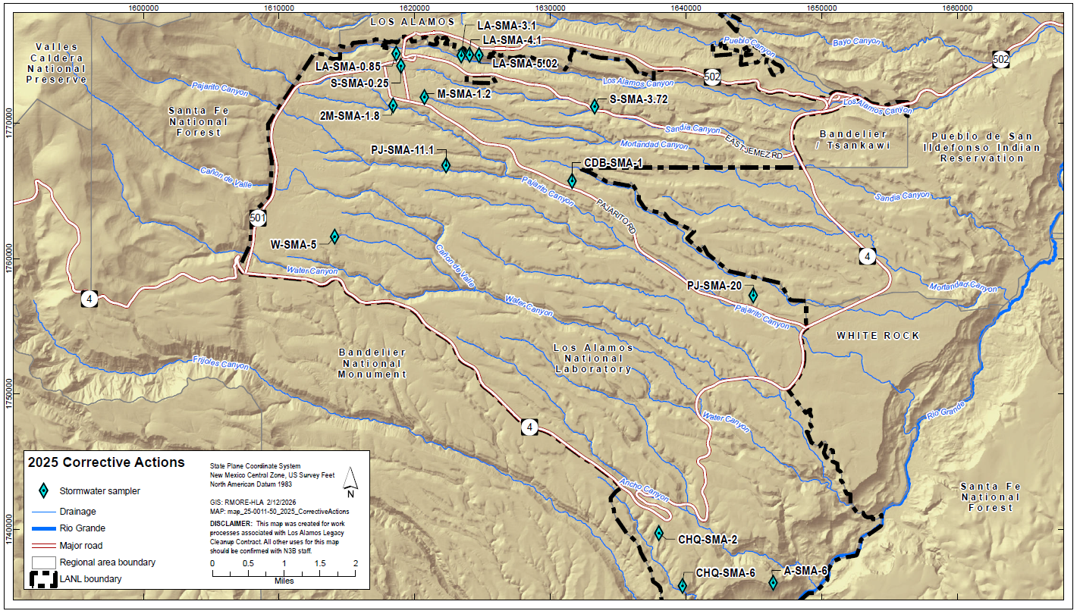
Corrective Actions Completed in 2025 – 15 SMAs

Slide 7
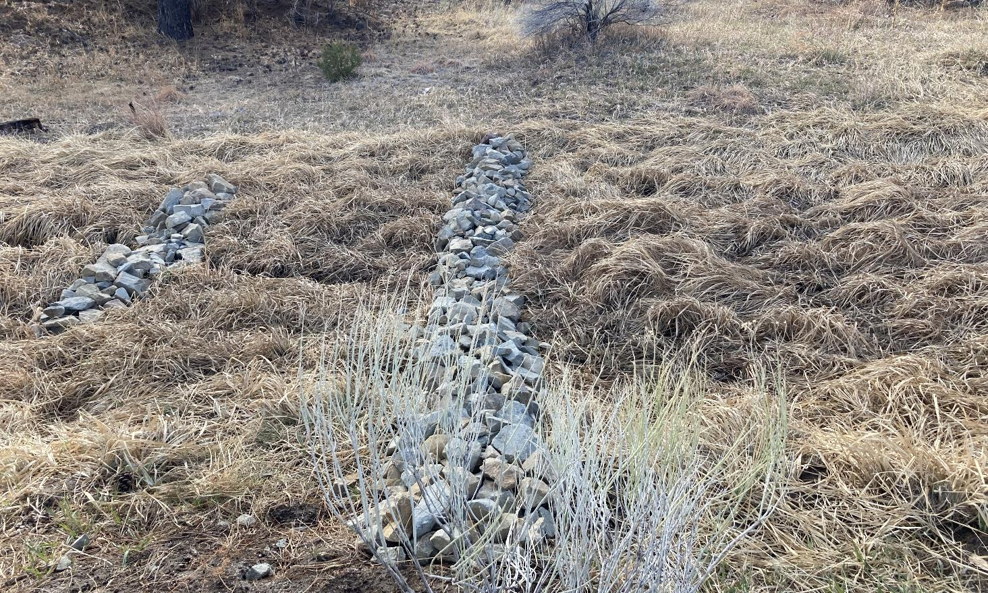
Corrective Actions Completed in 2025
LA-SMA-0.85
This site monitors SWMU 03-055(c), an outfall and storm drain.
Two samples collected in May 2023 had TAL exceedance ratios of 2.69 & 2.27 x copper.
The corrective action consisted of installing rock check dams.
Rock check dams L00106010012 and L00106010013 at LA-SMA-0.85 in Technical Area (TA) 03

Slide 8
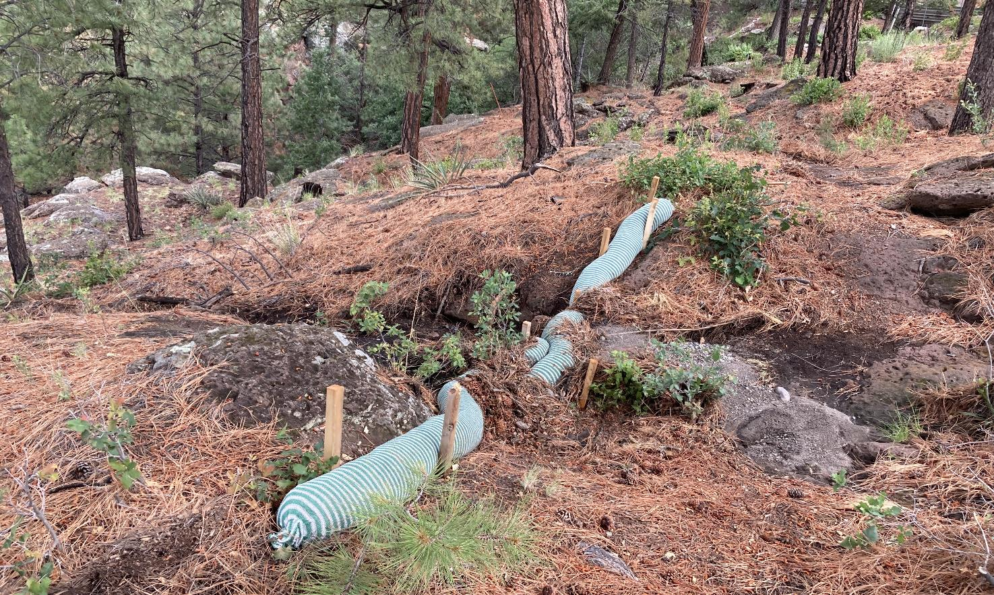
Corrective Actions Completed in 2025
LA-SMA-3.1
This site monitors SWMU 01-001(e), a septic tank and SWMU 01-003(a), a landfill.
Samples collected in October 2018, August 2023, May 2024, and June 2024 had TAL exceedance ratios of 5.2 x total PCBs, 2.3 x benzo(a)anthracene, 4.0 & 2.0 x benzo(a)pyrene, 8.3 & 3.7 x benzo(b)fluoranthene, 3.0 & 1.1 x benzo(k)fluoranthene, and 4.6 & 2.0 x Indeno(1,2,3-cd)pyrene.
The corrective action consisted of installing coir and compost logs.
Compost log L00803200014 at LA-SMA-3.1 in TA-43

Slide 9
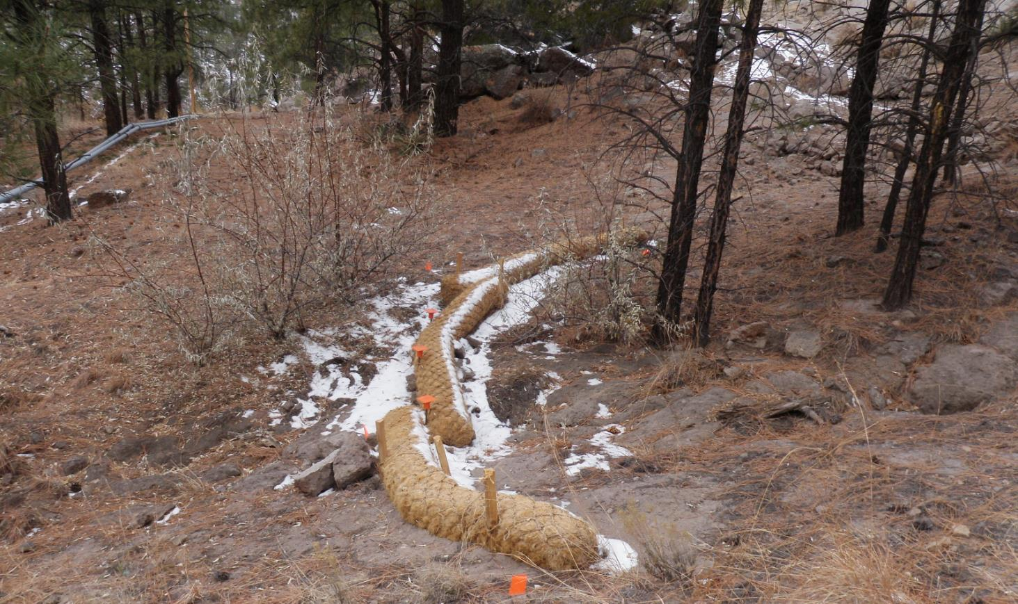
Corrective Actions Completed in 2025
LA-SMA-4.1
This site monitors SWMU 01-003(b1), a surface disposal site; SWMU 01-003(b2), a surface disposal site; and SWMU 01-006(b), drainlines and an outfall.
Samples collected in August & September 2011 had TAL exceedance ratios of 1.4 & 1.1 x copper and 1.6 x total PCBs.
The corrective action consisted of installing rock check dams and coir logs.
Coir log L00103140014 at LA-SMA-4.1 in TA-43

Slide 10
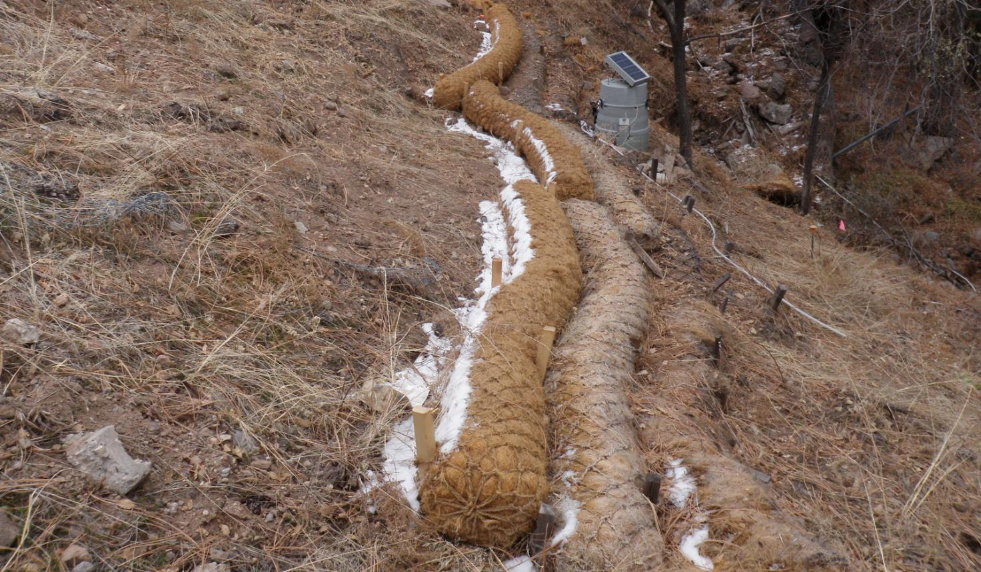
Corrective Actions Completed in 2025
LA-SMA-5.02
This site monitors AOC 35-016(b), a surface disposal site.
Sample collected in August 2011 had TAL exceedance ratios of 1.02 x copper and 4.3 x total PCBs.
The corrective action consisted of installing coir logs.
Coir log L012A03140030 at LA-SMA-5.02 in TA-43

Slide 11
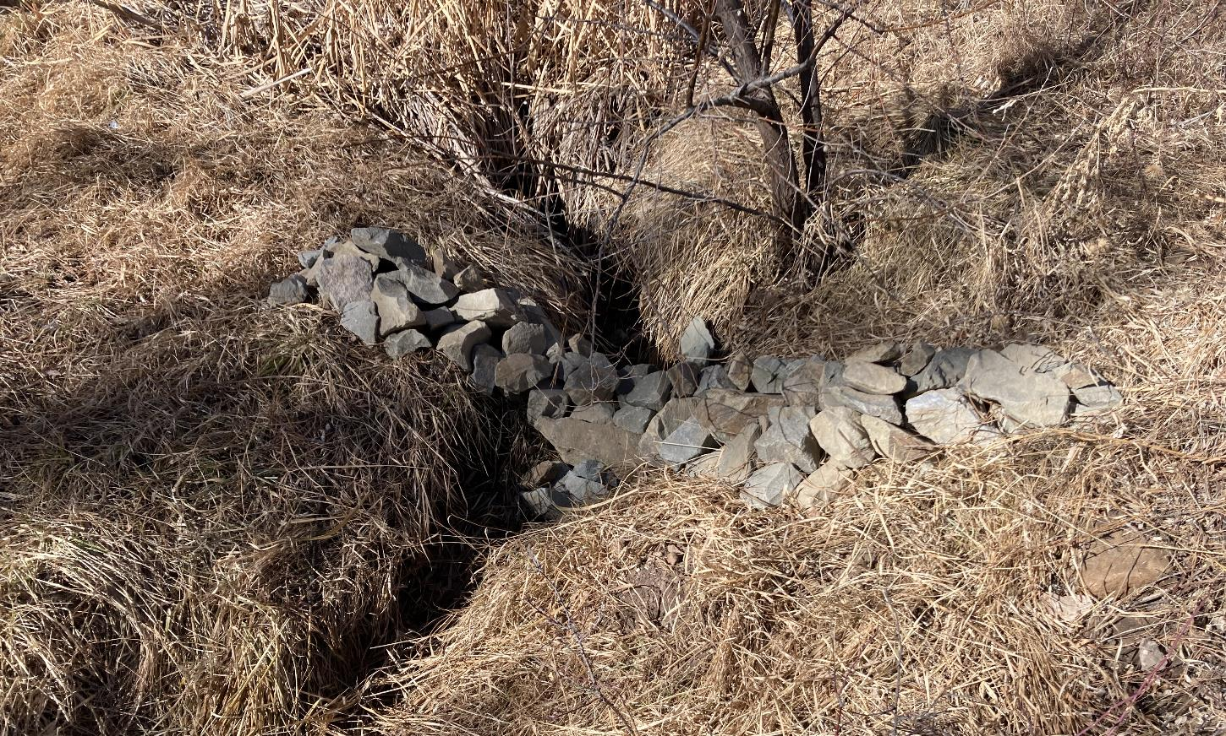
Corrective Actions Completed in 2025
S-SMA-0.25
This site monitors SWMU 03-013(a), a storm drain and SWMU 03-052(f), an outfall.
Sample collected in June 2016 had a TAL exceedance ratio of 6.6 x copper.
The corrective action consisted of installing rock check dams.
Rock check dam S00106010029 at S-SMA-0.25 in TA-03

Slide 12
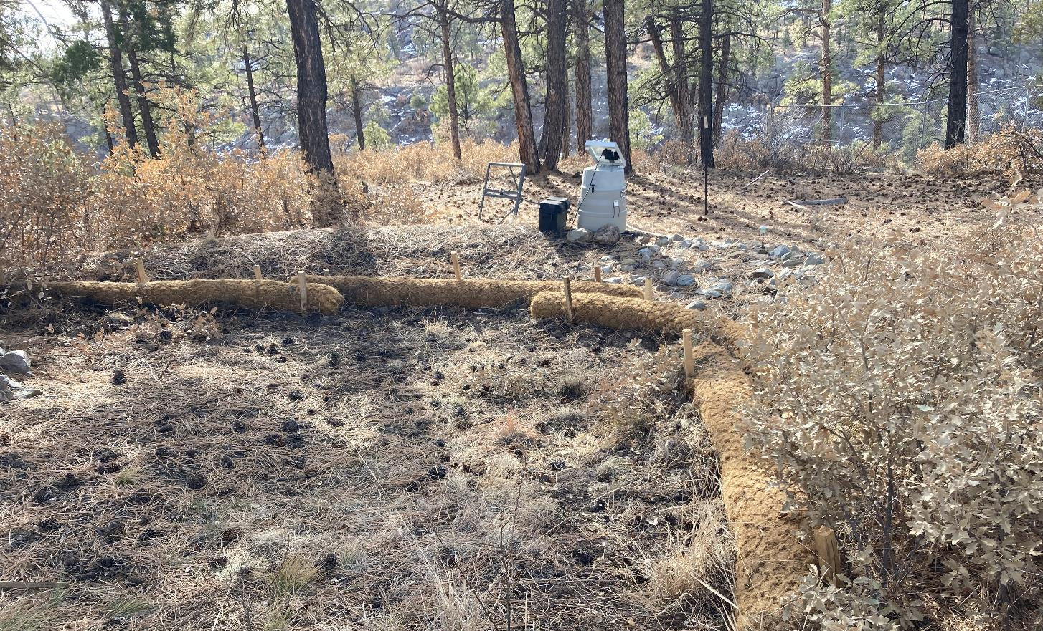
Corrective Actions Completed in 2025
S-SMA-3.72
This site monitors SWMU 53-001(b), a storage area.
Sample collected in June 2015 had a TAL exceedance ratio of 5.0 x total PCBs.
The corrective action consisted of installing coir logs.
Coir log S00903140012 at S-SMA-3.72 in TA-53

Slide 13
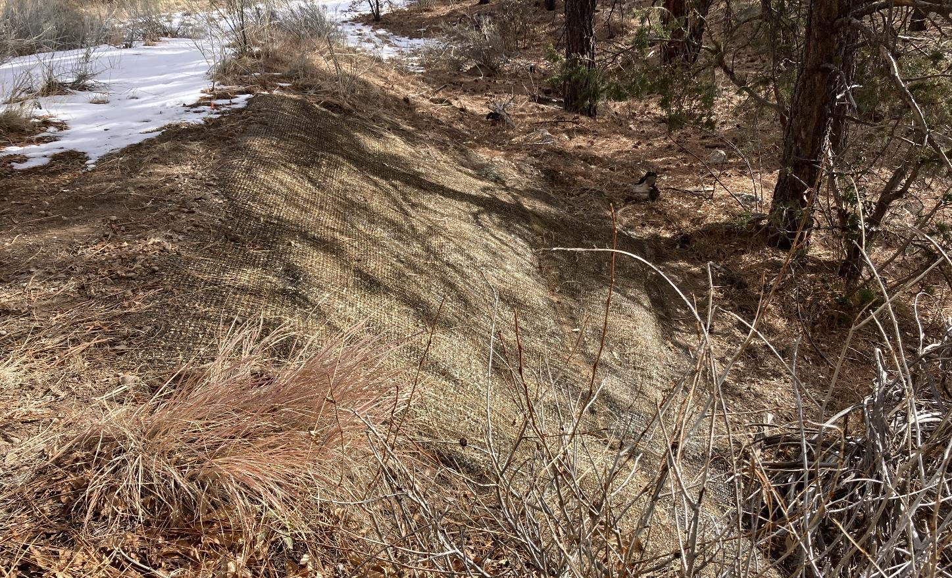
Corrective Actions Completed in 2025
M-SMA-1.2
This site monitors SWMU 03-049(a), an outfall from a cooling tower.
Sample collected in September 2017 had a TAL exceedance ratio of 12.9 x copper.
The corrective action consisted of installing coir logs and an erosion control blanket.
Erosion control blanket M00201060014 at M-SMA-1.2 in TA-03

Slide 14
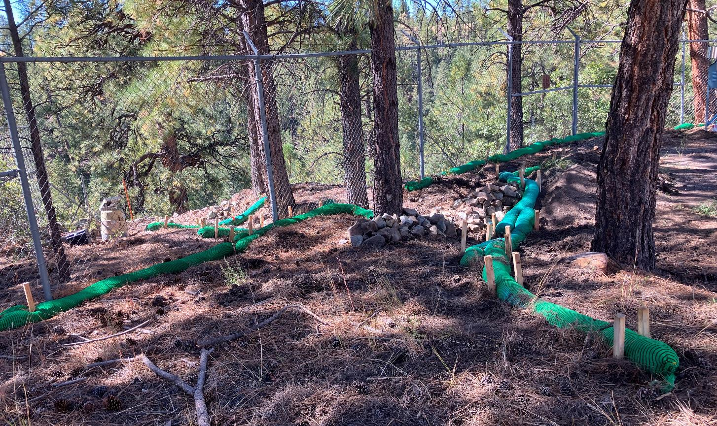
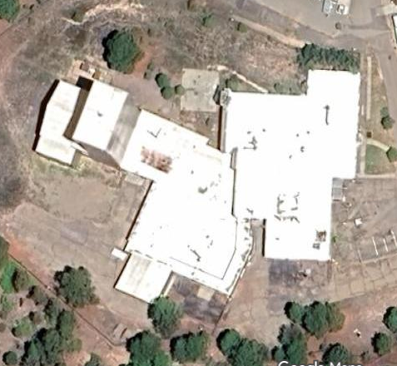
Corrective Actions Completed in 2025
2M-SMA-1.8
This site monitors SWMU 03-011(k), a storage area.
Samples collected in August 2021, May 2023, and June 2023 had TAL exceedance ratios of 2.68 x copper, 9.4 x benzo(b)fluoranthene, and 150 x total PCBs.
The corrective action consisted of installing compost logs.
Ion Beam Facility (building 03-0016) is actively being deactivated, decommissioned, and removed from the site monitoring area.
Compost logs E010060100013 at 2M-SMA-1.8 in TA-03 and Ion Beam Facility orthophoto (inset)

Slide 15
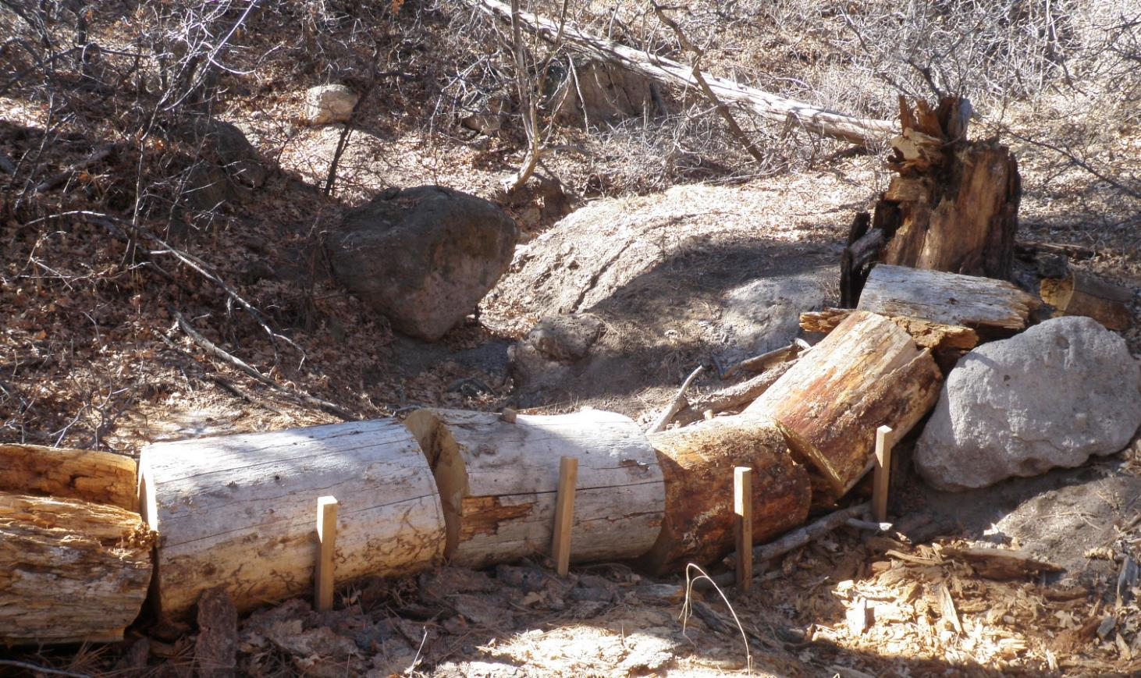
Corrective Actions Completed in 2025
CDB-SMA-1
This site monitors SWMU 46-003(c), a septic system; SWMU 46-004(d2), soil contamination from stack emissions; SWMU 46-004(f), an outfall; SWMU 46-004(t), an outfall; SWMU 46-004(w), an outfall, SWMU 46-008(g), a storage area; and SWMU 46-009(a), a landfill.
Sample collected in August 2021 had a TAL exceedance ratio of 2.68 x copper.
The corrective action consisted of installing log checks dams.
Log check dam C00406020023 at CDB-SMA-1 in TA-46

Slide 16
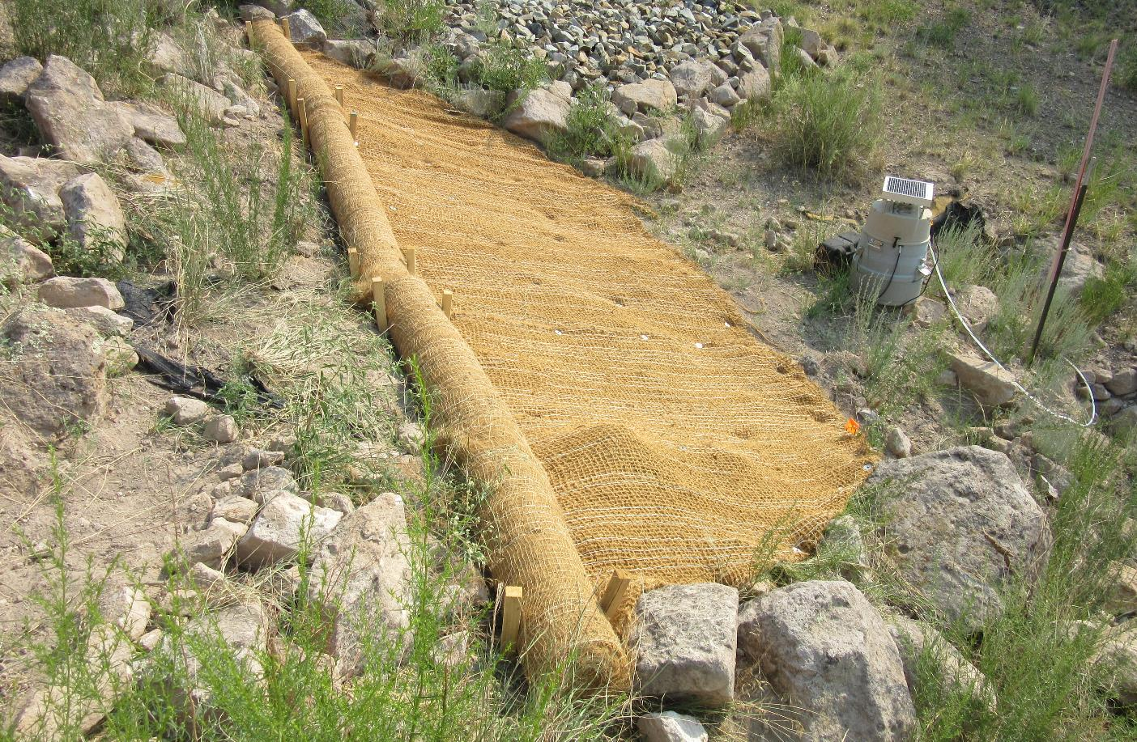
Corrective Actions Completed in 2025
PJ-SMA-11.1
This site monitors AOC 40-003(b), a burning area.
Sample collected in August 2021 had a TAL exceedance ratio of 8.64 x copper.
The corrective action consisted of installing coir rolls.
Coir roll J01403210025 at PJ-SMA-11.1 in TA-40

Slide 17
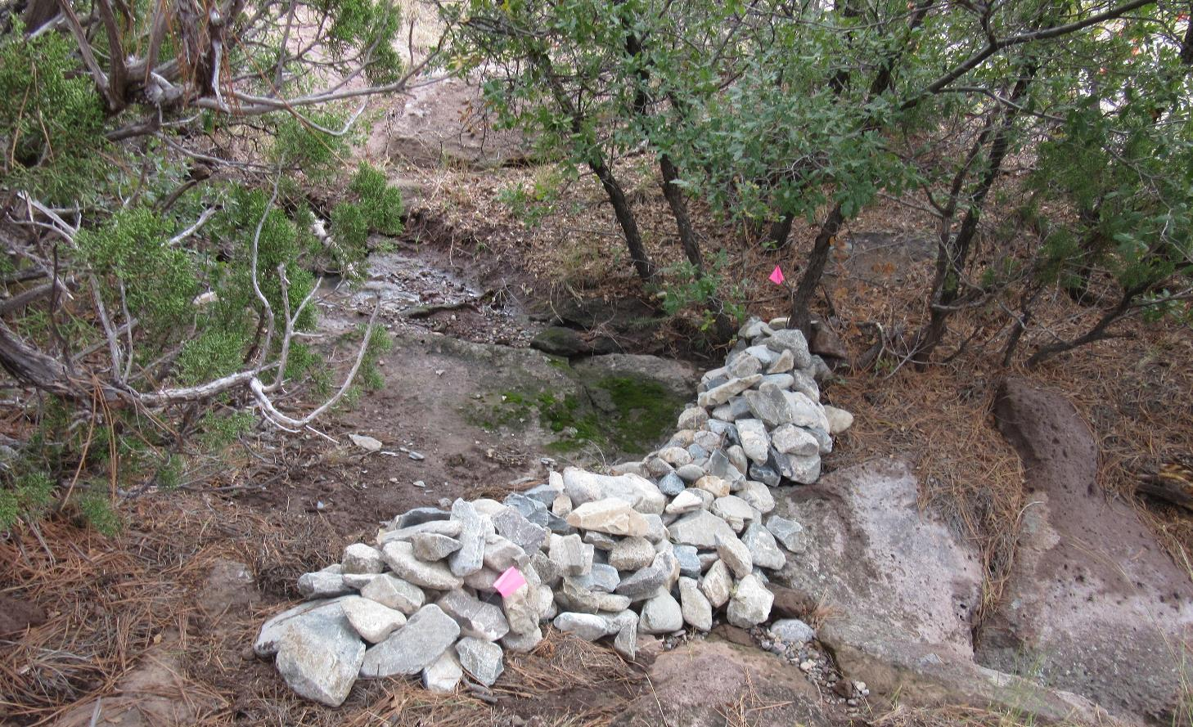
Corrective Actions Completed in 2025
PJ-SMA-20
This site monitors SWMU 54-017, inactive disposal pits at Area G.
Samples collected in July 2011, May 2014, and June 2023 had TAL exceedance ratios of 1.86, 1.73 & 1.97 x copper.
The corrective action consisted of installing rock check dams.
Rock check dam J02706010008 at PJ-SMA-20 in TA-54

Slide 18
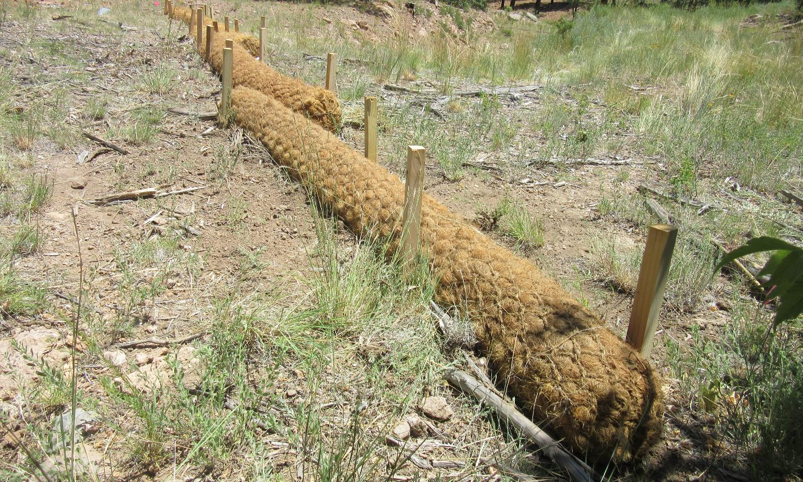
Corrective Actions Completed in 2025
W-SMA-5
This site monitors SWMU 16-001(e), a dry well, SWMU 16-003(f), sumps; SWMU 16-026(b), an outfall; SWMU 16-026(c), an outfall; SWMU 16-026(d), an outfall; and SWMU 16-026(e), an outfall.
Sample collected in August 2023 had TAL exceedance ratios of 2.0 x benzo(a)anthracene and 2.4 x benzo(b)flouranthene.
The corrective action consisted of installing coir logs and wood chip wattles.
Coir log W00603160037 at W-SMA-5 in TA-16

Slide 19
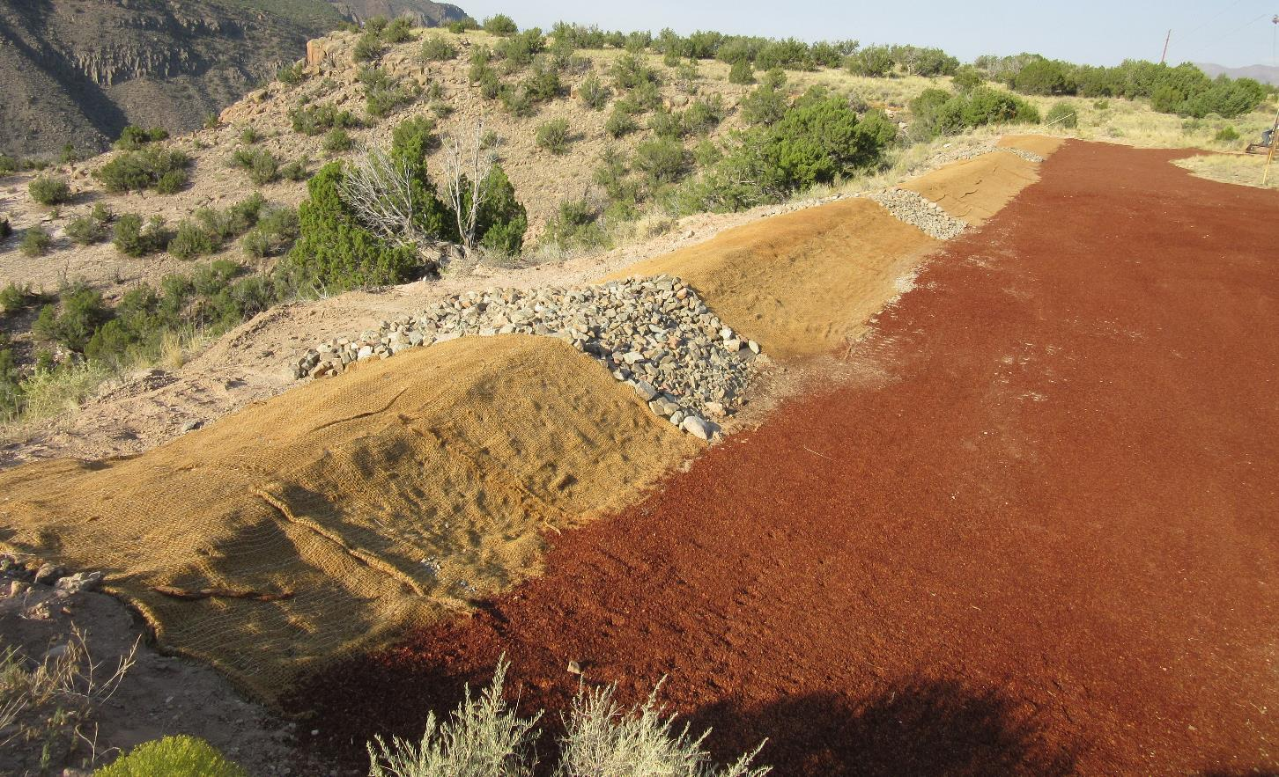
Corrective Actions Completed in 2025
A-SMA-6
This site monitors SWMU 33-004(k), drainlines; SWMU 33-007(a), a gun-firing site; SWMU 33-010(a), a surface disposal site; and SWMU 33-010(b), a canyon-side disposal site.
Samples collected in August 2013 and August 2023 had TAL exceedance ratios of 1.11 x copper and 110 x total PCBs.
The corrective action consisted of installing coir logs and an earthen berm with three rock spillways.
Earthen berm A00903010024 at A-SMA-6 in TA-33

Slide 20
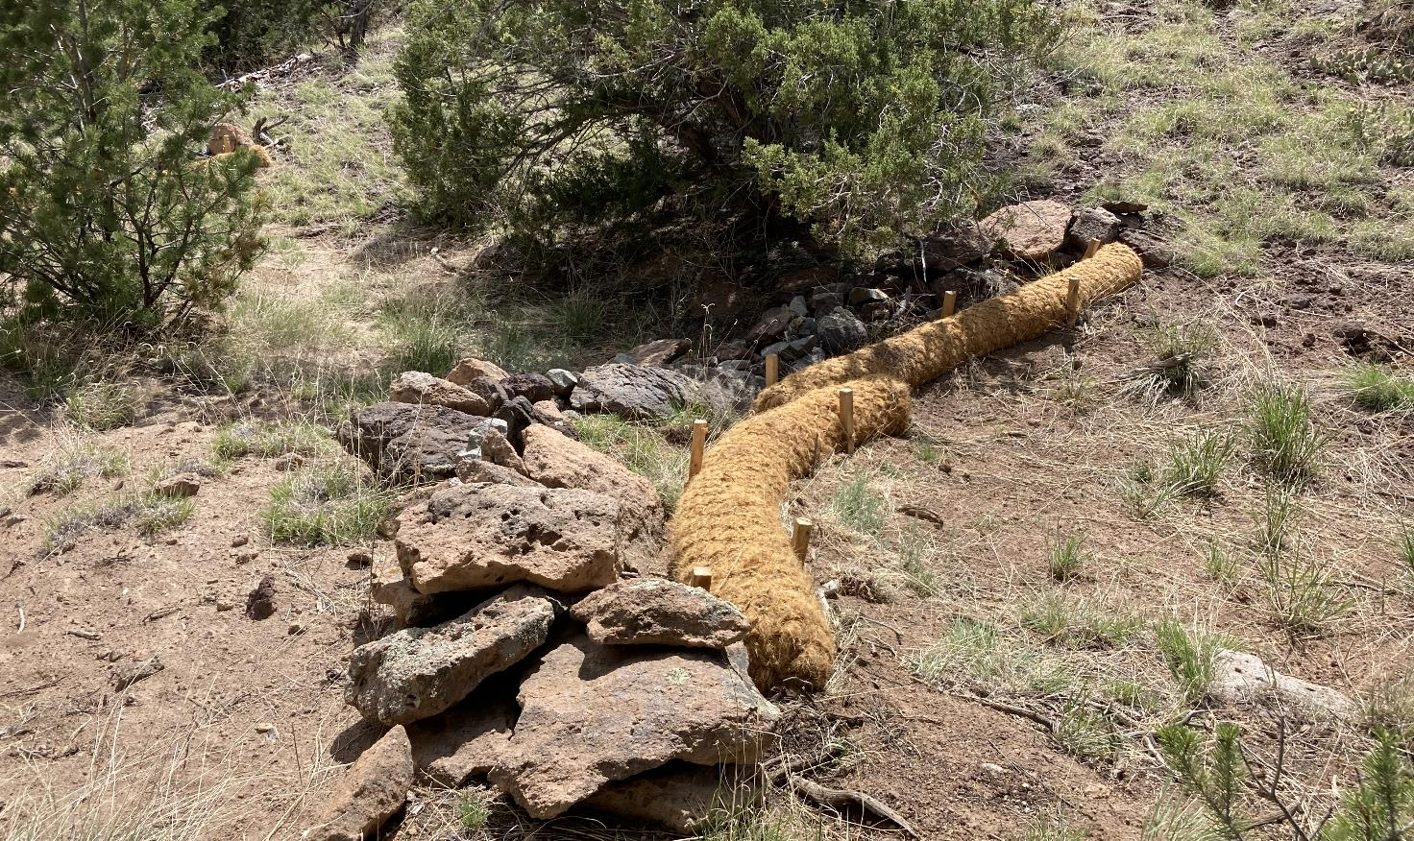
Corrective Actions Completed in 2025
CHQ-SMA-2
This site monitors SWMU 33-004(d), a septic system; SWMU 33-007(c), a firing site; and AOC C-33-003, soil contamination.
Samples collected in July 2022 and August 2023 had TAL exceedance ratios of 1.26 x copper and 1.1 x total PCBs.
The corrective action consisted of installing coir logs.
Natural rock check dam Q00306010049 and new coir log Q00303140067 at CHQ-SMA-2 in TA-33

Slide 21
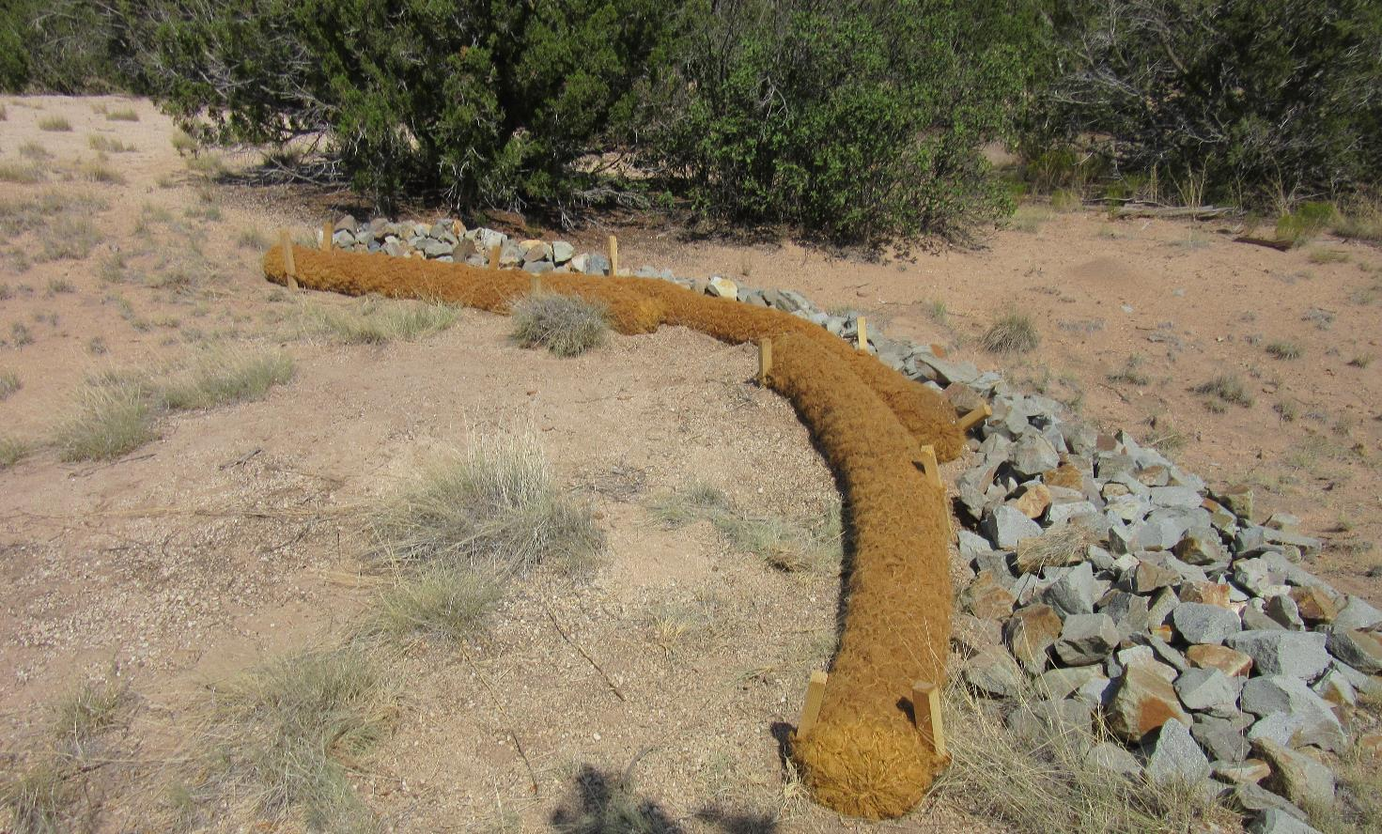
Corrective Actions Completed in 2025
CHQ-SMA-6
This site monitors 33-004(j), a drainline and an outfall; SWMU 33-006(a), a firing site; SWMU 33-007(b), a firing site; SWMU 33-010(c), a surface disposal site; SWMU 33-010(h), a surface disposal site; and SWMU 33-014, a burn site.
Samples collected in July 2022 and September 2023 had TAL exceedance ratios of 9.10 & 6.18 x copper.
The corrective action consisted of installing coir logs.
Rock check dam Q00902040036 and new coir log Q00903140053 at CHQ-SMA-6 in TA-33

Slide 22
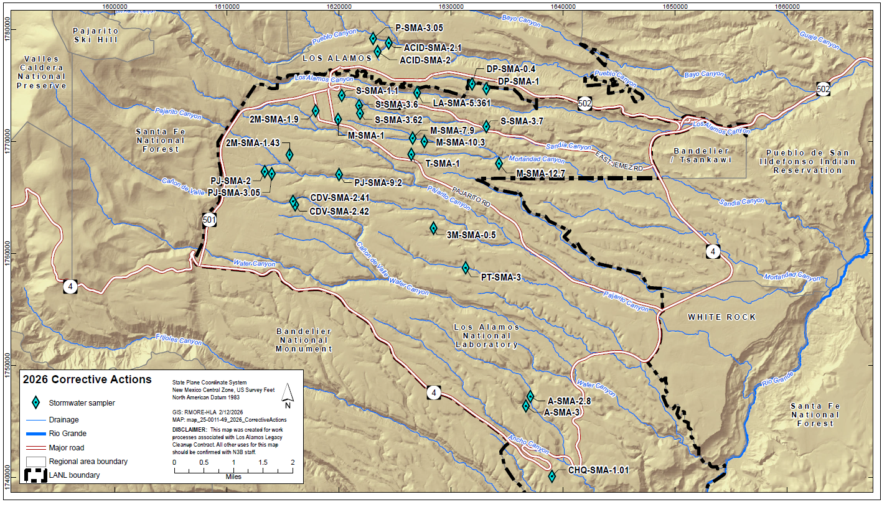
Corrective Actions Scheduled for 2026 – 27 SMAs

