Slide 1
2025 Individual Permit
Monitoring Season Summary
  March 4, 2026
Audrey Krehlik
  Surface Water Deliverable Team Lead

Slide 2
Presentation Outline
Individual Permit Summary
2025 Precipitation and Samples Collected
2025 Target Action Level Exceedances
2025 Sampling Implementation Plan (SIP)
2025 Success Stories

Slide 3
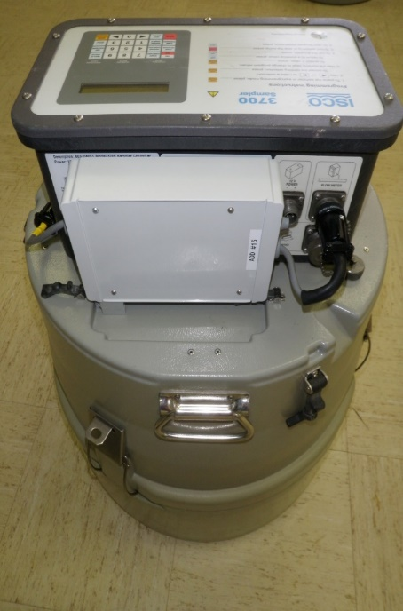
Individual Permit Summary
The Individual Permit (NM0030759) regulates discharges of stormwater from certain Solid Waste Management Units (SWMUs) and Areas of Concern (AOCs), referred to as “Sites”, at Los Alamos National Laboratory.
U.S. Environmental Protection Agency (EPA) issued the original Permit in 2010. The current Permit, which supersedes the original Permit, became effective August 1, 2022.
The Permit lists 397 Sites that must be managed to prevent the transport of pollutants of concern to surface waters via stormwater run‑off.
The 397 Sites are managed under 239 Site Monitoring Areas.
The Individual Permit is a technology-based permit that relies on stormwater control measures to minimize discharges of pollutants into stormwater.
Automated stormwater sampler

Slide 4
Individual Permit Summary: Site Monitoring Area
Drainage boundary, or Site Monitoring Area (SMA)
Stormwater
Stormwater run-on control
SWMU/AOC
Stormwater run-on control
Solid Waste Management Unit (SWMU) or Area of Concern (AOC)
SWMU/AOC
Stormwater runoff controls
Stormwater runoff controls
Sampler

Slide 5
2025 Precipitation and Samples Collected
Precipitation
Samples Collected
1,722 sampler inspections in 2025
36 samples collected from 25 Site Monitoring Areas in 2025
Samplers were active May 1 through November 21, 2025

Slide 6
2025 Target Action Level (TAL) Exceedances
24 exceedances from 14 Site Monitoring Areas
SMA | Exceedance(s)
2M-SMA-1.7 | Total PCBs (19 x TAL)
2M-SMA-1.9 | Total PCBs (2000 x), Total PCBs (100 x), Hexachlorobenzene (6 x)
2M-SMA-2 | Total PCB (73 x), Copper (2 x), Zinc (1.5 x), Total PCB (8 x), Copper (3 x), Zinc (3 x)
CDV-SMA-9.05 | Hexachlorobenzene (5 x)
LA-SMA-0.85 | Copper (2 x), Copper (5 x)
LA-SMA-9 | Hexachlorobenzene (3 x)
M-SMA-4 | Hexachlorobenzene (7 x)
PJ-SMA-3.05 | Copper (1.3 x)
PJ-SMA-9 | Hexachlorobenzene (5 x), Copper (3 x)
P-SMA-0.3 | Total PCBs (6 x)
PT-SMA-3 | Aluminum (8 x)
S-SMA-0.25 | Copper (2 x), Copper (2 x)
S-SMA-3.61 | Total PCBs (2 x)
STRM-SMA-4.2 | Total PCBs (25 x)
Note: “2 x”, for example, indicates 2 times the TAL

Slide 7
2025 Sampling Implementation Plan (SIP)
The draft 2025 Sampling Implementation Plan was submitted to the New Mexico Environment Department for comment on January 15, 2026. The final version is due to EPA by March 31, 2026.
Site Monitoring Area (SMA) status categories:
 | 2025 Season | 2026 Season (proposed)
Active Monitoring | 146 | 151
Active Monitoring/ Corrective Action | 33 | 23
Corrective Action | 20 | 20
Long-Term Stewardship | 33 | 35
Eligible for SMA Deletion | 8 | 8
3-yr, 24-hr Certification | 0 | 3

Slide 8
2025 Success Stories
18 samples from 12 Site Monitoring Areas were collected with no TAL exceedances.
SMA | Path Foward
2M-SMA-3 | Active Monitoring continues
CDB-SMA-4 | Active Monitoring continues
CHQ-SMA-2 | Active Monitoring continues
CHQ-SMA-6 | Active Monitoring continues
LA-SMA-4.1 | SMA Deletion
M-SMA-7.9 | This SMA moves from Active Monitoring/Corrective Action status to Corrective Action
PJ-SMA-17 | Active Monitoring continues
PJ-SMA-19 | Long-Term Stewardship per Permit Part I.C.3.a
PJ-SMA-20 | Active Monitoring continues
P-SMA-0.3 | Corrective action will be initiated for PCBs while active monitoring continues for a second sample for hexachlorobenzene
T-SMA-3 | Active Monitoring continues
W-SMA-1.5 | Active Monitoring continues

Slide 9
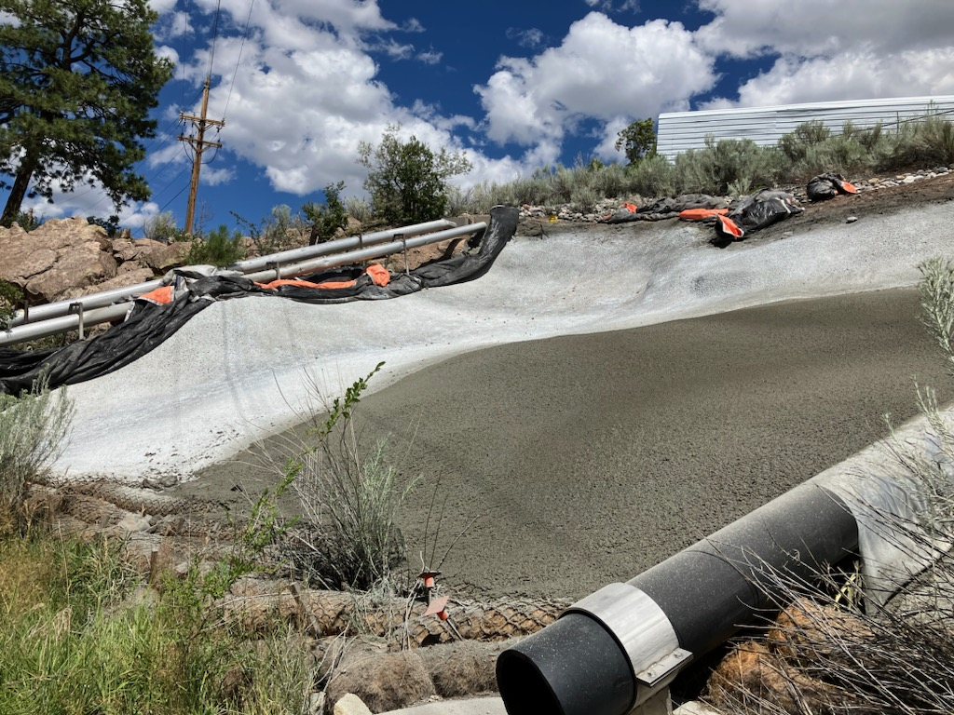
2025 Success Stories
Enhanced controls were certified at S-SMA-2 in September 2024. Since then, there have been no PCB Aroclor detections at the associated downstream gaging station (E121).
Shotcrete cap S00308060028 at S-SMA-2 in TA-3.

Slide 10
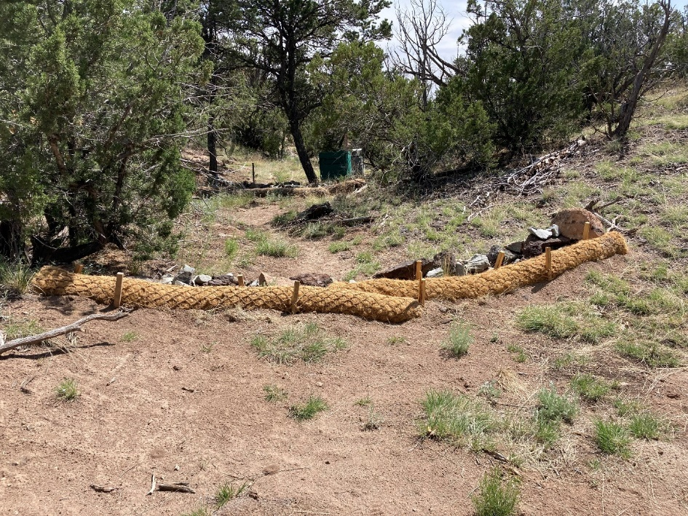
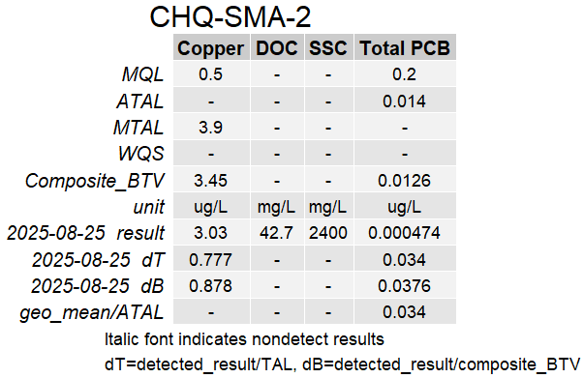
2025 Success Stories
Enhanced controls for copper and PCBs exceedances were certified at CHQ-SMA-2 in July 2025.
Copper and PCBs were both below the applicable TALs in the August 2025 stormwater sample.
Coir logs Q00303140066 at CHQ-SMA-2 in TA-33.
MQL = Minimum Quantification Level, ATAL = Average Target Action Level, MTAL = Maximum Target Action Level, WQS = Water Quality Standard, BTV = Background Threshold Value, DOC = Dissolved Organic Carbon, SSC = Suspended Sediment Concentration

Slide 11
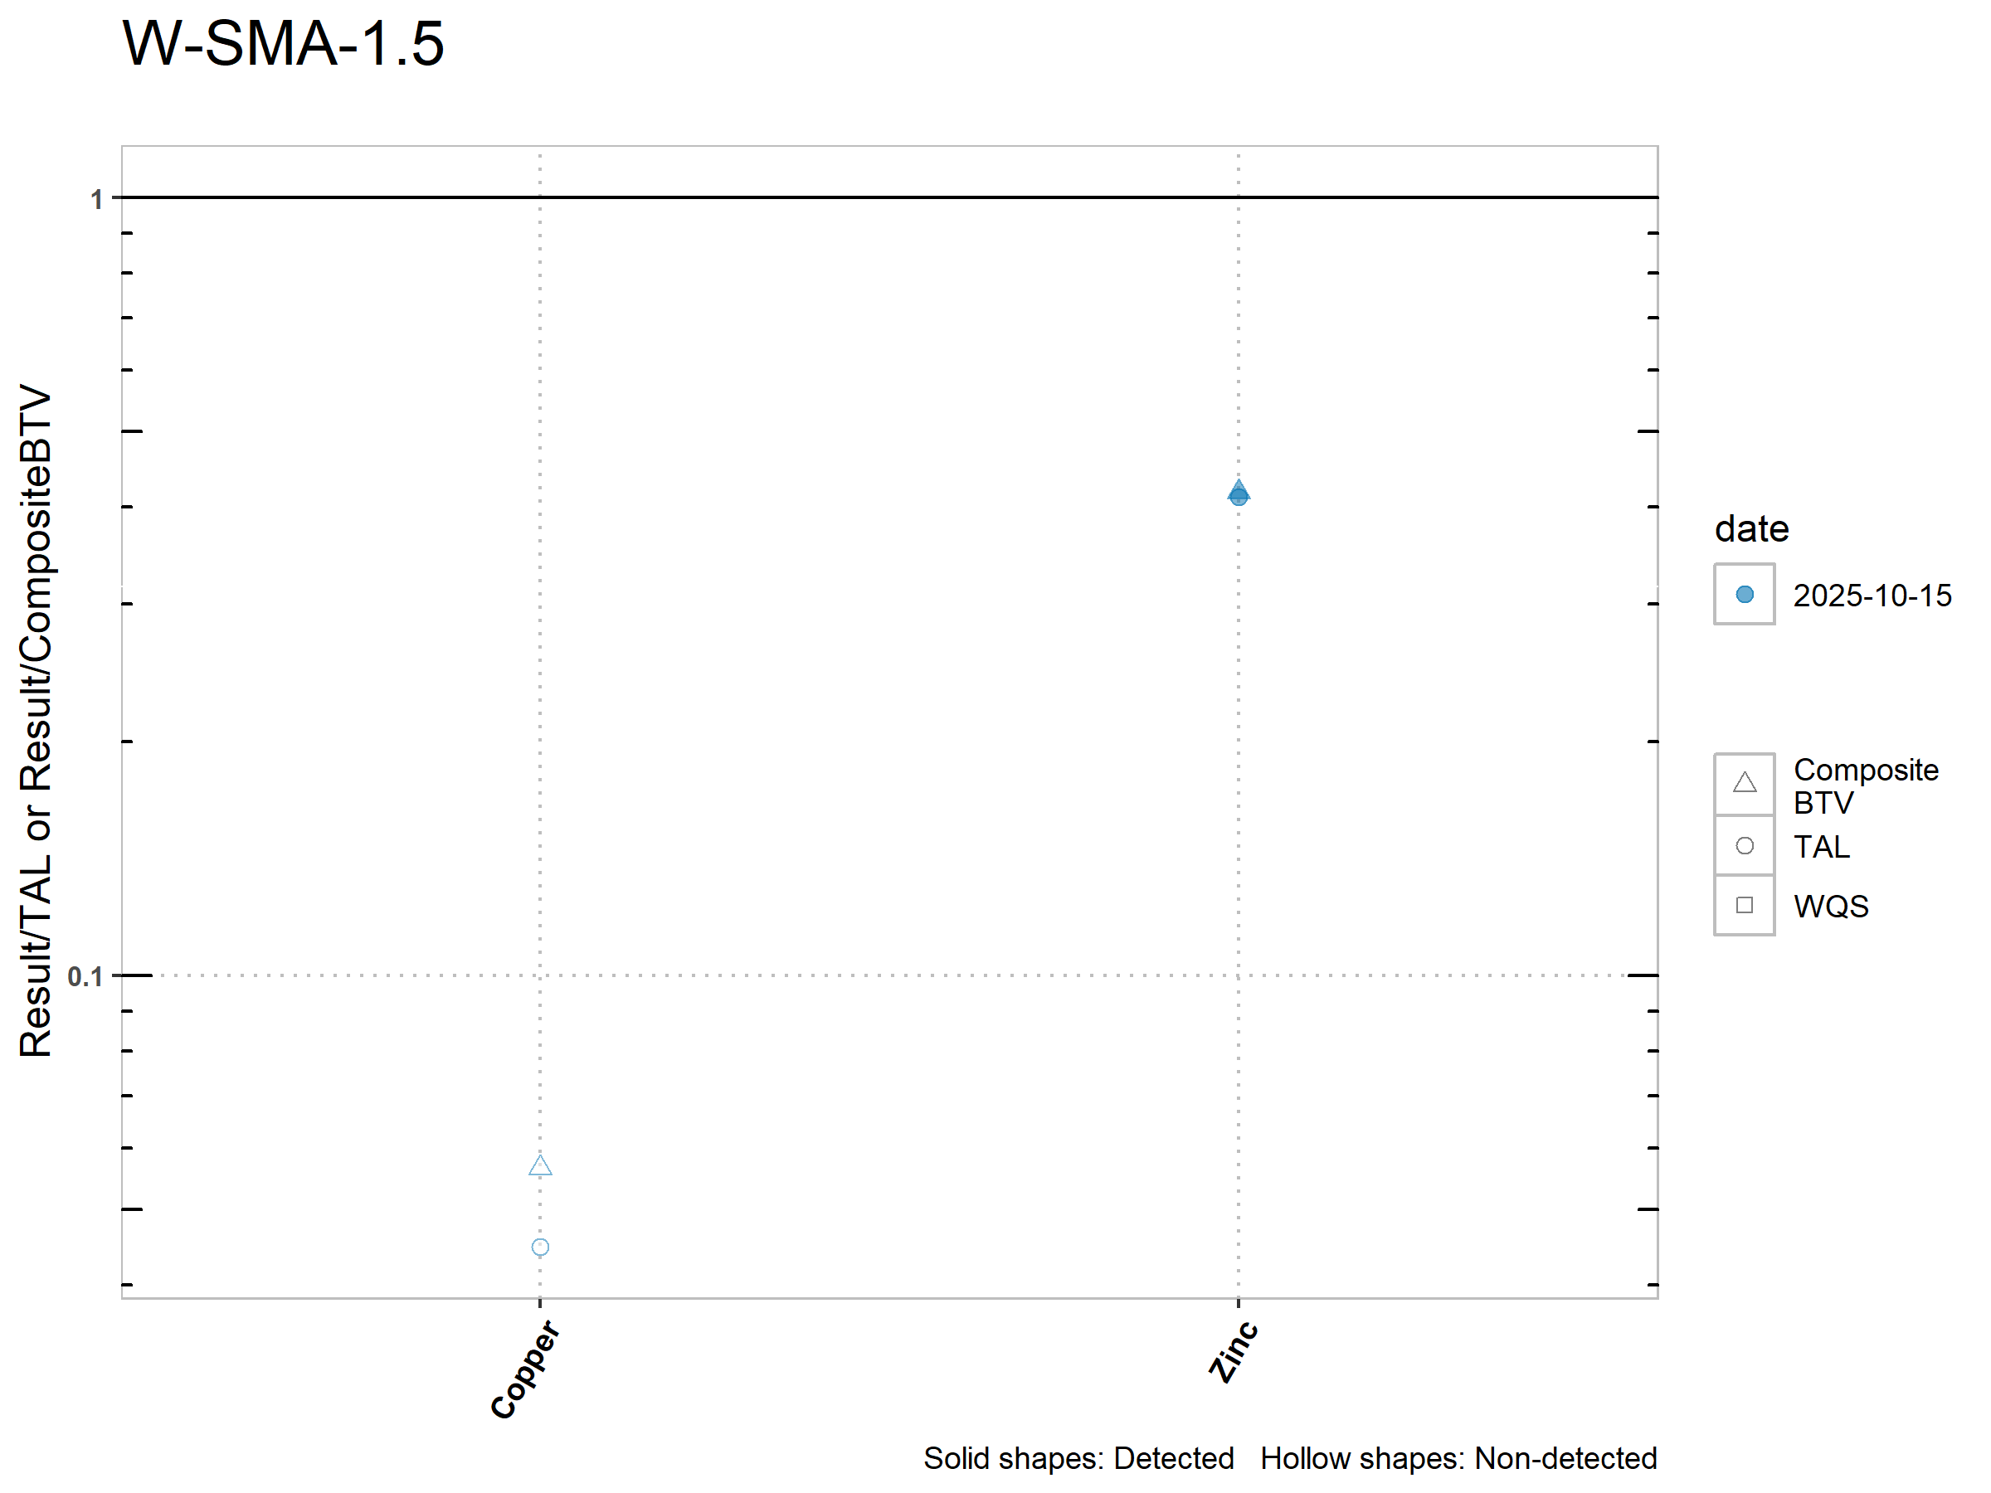
2025 Success Stories
Enhanced controls for copper and zinc exceedances were certified at W-SMA-1.5 in April 2024.
Copper and zinc were both below TAL in the October 2025 stormwater sample.

